Slide 1
Proposal to Change Waiting Time Criteria for Kidney-Pancreas Candidates
Pancreas Transplantation Committee
Notes:
Hello, my name is ___ and I am a member of the Pancreas Transplantation Committee. Today, I will be presenting the Committee’s Spring 2018 “Proposal to Change Waiting Time Criteria for Kidney-Pancreas Candidates”

Slide 2
Background
In order to accrue waiting time, KP candidates must be:
On insulin and have a C-peptide ≤ 2 ng/mL OR
On insulin, have a C-peptide > 2 ng/mL and a body mass index (BMI) below the maximum (currently 30 kg/m²)
Waiting time accrual is important to SPK candidates because it impacts allocation
Notes:
In order to accrue waiting time, policy requires kidney-pancreas candidates to be on insulin and either have a C-peptide less than or equal to 2 ng/mL, or have a C-peptide > 2 and a BMI less than or equal to the maximum allowable BMI (currently 30). This change was implemented as part of the pancreas allocation system (PAS) in 2014.
It is important to understand that C-peptide is sometimes used as an approximation of diabetes status: for example, Type 2 diabetes is often associated with higher C-peptide values compared to Type 1 diabetes. The KP waiting time criterion restricts a Type 2 high BMI candidate’s ability to accrue waiting time, since Type 1 candidates may have high BMIs but still qualify to accrue waiting time because of a low C-peptide. Waiting time accrual is critical for KP candidates because it impacts allocation.
Since PAS was implemented in 2014, the Pancreas Committee has reviewed the maximum allowable BMI every 6 months to determine if it should be modified.

Slide 3
Background
Max BMI calculated every 6 mos., based on % active KP candidates that meet criterion 3.b (on insulin, C-peptide > 2, BMI ≤ maximum).
Max BMI cannot exceed 30 kg/m²
Notes:
Increasing or lowering the maximum allowable BMI is based on the percentage of active KP candidates on insulin with a C-peptide greater than 2 and a BMI below the maximum (table 11-1 on the slide). If the percent is greater than 15% nationally, the max BMI is lowered by 2. If it is less than 10% nationally, the max BMI is increased by 2.
The maximum allowable BMI at implementation of PAS was 28, and was changed to 30 after 6 month review. Subsequent 6 month analyses have indicated the maximum BMI should be raised further because low C-peptide, high BMI candidates still represented less than 10% nationally. However, current policy states that the maximum can’t exceed 30. Modification of the BMI threshold served as an indicator to the Committee that the qualifying criteria should be re-evaluated.

Slide 4
What problems will the proposal solve?
Criterion restricts waiting time accrual for Type 2 high BMI candidates without a medical basis
Well-selected high BMI Type 2 recipients may have comparable outcomes to other SPK recipients
Policy is unfair in allowing Type 1, but not Type 2 candidates with high BMIs to accrue waiting time
Notes:
We found that the criterion restricts waiting time accrual for Type 2 high BMI candidates without a medical basis for the exclusion. Significant evidence shows that Type 2 high BMI candidates, if well-selected, may have comparable outcomes to other SPK recipients. The policy is also unfair in that it allows Type 1 candidates with high BMIs to accrue waiting time, while high BMI Type 2 candidates are restricted. The Committee discovered no evidence that high BMI Type 1 recipients showed better outcomes than high BMI Type 2 recipients, and indeed found some evidence suggesting high BMI Type 1 recipients may have worse outcomes than other SPK recipients, including high BMI Type 2 recipients.

Slide 5
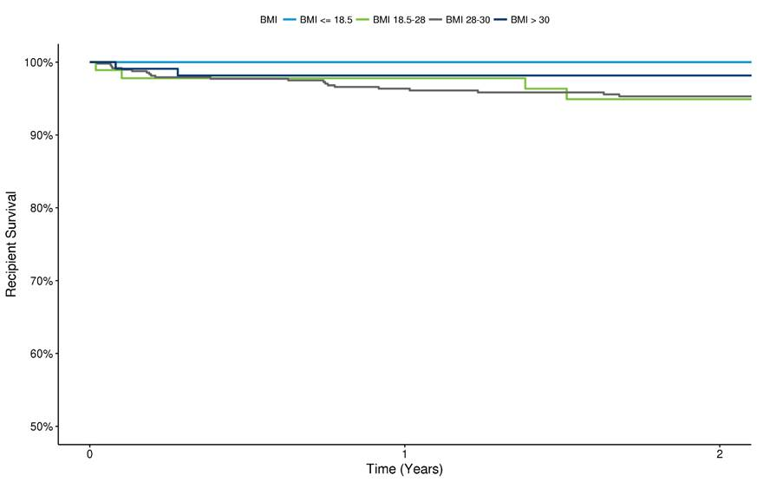
Recipient Survival by BMI
Notes:
This graph comes from analysis we requested to identify SPK recipient survival by BMI. BMI > 30 is marked by the dark blue line. The graph shows that higher BMI SPK recipients may have comparable patient survival to candidates with BMIs between 18.5 and 30.
[if there are questions about how many were included in each of the cohorts: BMI > 30 (n=92), BMI 28-30 (n = 114), BMI 18.5-28 (n=504), BMI <=18.5 (n=9). The data is from a 2004-2014 cohort with 2 year follow up for recipient survival. The analysis did not stratify by diabetes type]

Slide 6
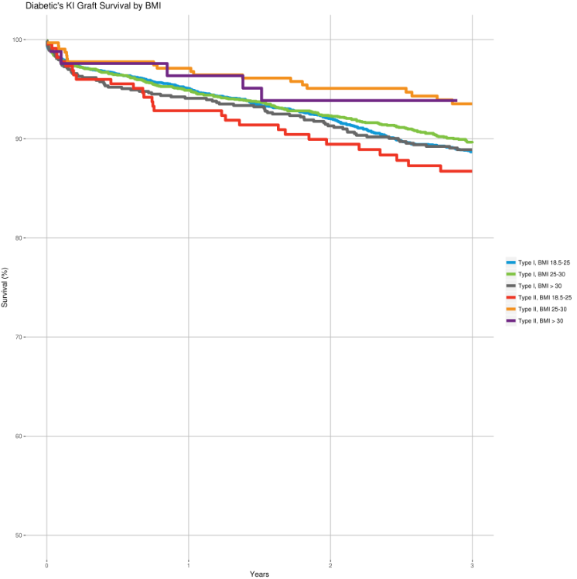
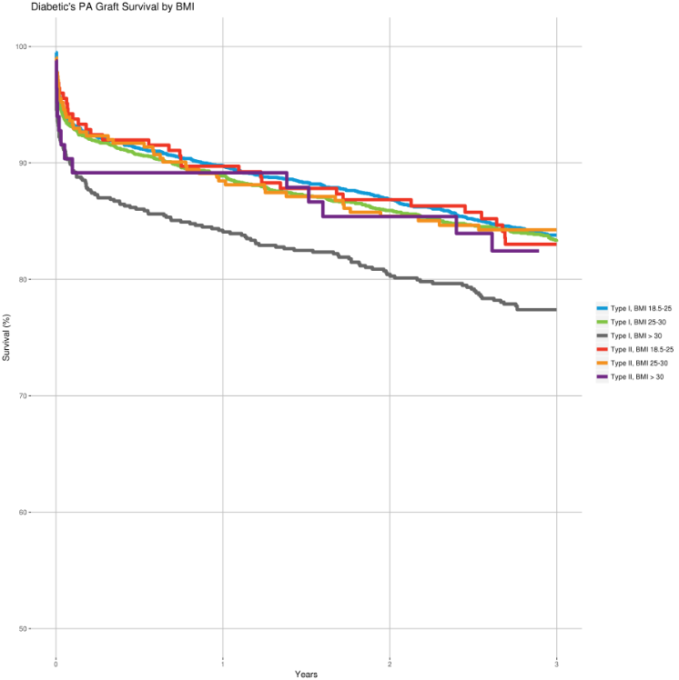
Graft Survival by BMI
Notes:
These figures show kidney and pancreas graft survival for Type 1 and Type 2 recipients, stratified by BMI. The purple line in each graph represents Type 2 BMI > 30 recipients. These figures highlight that well-selected Type 2 recipients with higher BMIs may have comparable outcomes to Type 1 recipient outcomes for both kidney and pancreas graft survival. In fact, the analysis indicates that outcomes for Type 1 recipients with BMIs greater than 30 may have worse pancreas graft survival than other SPK recipients. This highlights that the current KP waiting time criterion restricting access for Type 2 candidates is unfair.
[graphs are from an abstract submitted for 2018 ATC. . The authors analyzed UNOS data from 2006-2013 using a cohort of 6631 SPK recipients, including 622 Type 2 recipients.]

Slide 7
What problems will the proposal solve?
No need for criterion limiting T2 transplants; very few Type 2 SPK patients are transplanted with a higher BMI
OPTN/UNOS analysis of a 2006-2016 cohort showed no trends in increasing Type 2 KP recipients and registrations
From 2004-2014 (before any restriction on waiting time accrual), there were on average < 9 Type 2 recipients with BMI ≥ 30 per year nationally
Notes:
When PAS went out for public comment in 2010, there were concerns about the impact on kidney alone populations that led to the inclusion of the waiting time criterion. However, all available data suggests that removing the criterion would have a minimal impact on kidney alone populations. The Committee reviewed data on SPK registrations and recipients from 2006-2016 to examine whether Type 2 registrations or transplants were increasing. However, no trends were seen. Thus, this concern raised in PAS no longer applies.
It’s also important to note that before any restriction was in place for Type 2 diabetics, there were on average less than 9 transplants of high BMI Type 2 KP recipients every year over the course of a decade, or 87 in total. This suggests that programs will show discretion in deciding which candidates are appropriate for transplant, and that programs are unlikely to abuse the lack of restriction.

Slide 8
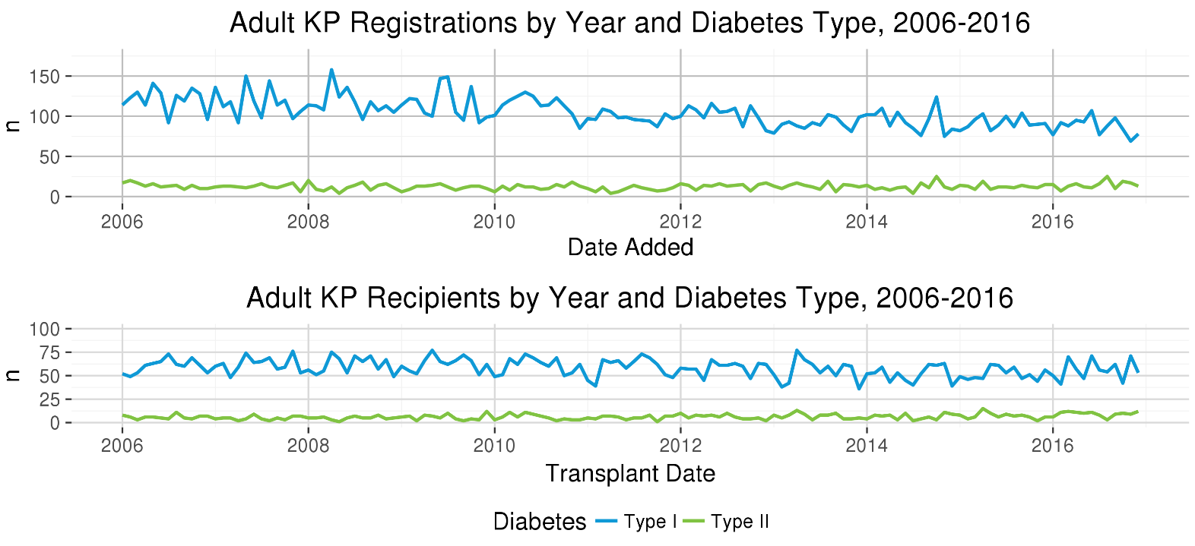
Registrations/recipients by year, DM type
Notes:
Because of concerns raised about whether Type 2 KP transplantation is increasing at a significant rate, we analyzed data regarding KP registrations and recipients by year and diabetes type. As the graphs above indicate, while Type 1 registrations have dropped slightly, Type 2 registrations and Type 2 recipients have held steady over the past decade and no trends were seen regarding Type 2 transplant rates. Thus, the data suggests there are no trends in Type 2 KP transplants.

Slide 9
What problems will the proposal solve?
Otherwise acceptable transplant candidates denied opportunity to accrue waiting time
Asian, African American and Hispanic populations are disproportionately impacted by the criterion because they represent a greater proportion of high BMI Type 2 SPK candidates and recipients
Notes:
Finally, this policy unfairly limits access to transplant for certain populations of candidates. Substantial evidence indicates that Type 2 candidates can be successfully transplanted, even when these recipients have a BMI above 30. Specifically, Asian, African American and Hispanic populations represent a greater proportion of Type 2 high BMI simultaneous pancreas-kidney (SPK) candidates and recipients, whose waiting time is currently restricted, and who would benefit from the removal of this KP waiting time criterion.

Slide 10
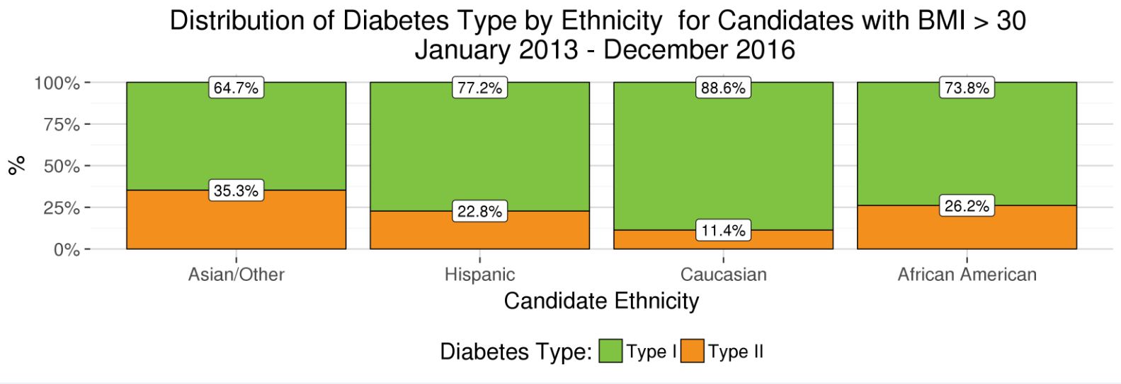
Minority SPK Candidates
Notes:
This slide shows that the proportion of high BMI Type 2 KP candidates is greater for minority populations than for Caucasian populations from 2013 to 2016. A higher percentage of Asian, Hispanic and African American candidates with BMI > 30 kg/m² are Type 2 diabetics, and are thus directly impacted by the current KP waiting time criterion. For example, 26% of African American and 35% of Asian candidates with high BMIs cannot accrue waiting time, compared to just 11% of Caucasians. Eliminating this restriction for patients with Type 2 diabetes may increase relative access to pancreas transplantation for certain minority patients, by allowing them to accrue waiting time.
(among all 104 Type 2 candidates with high BMIs from 2013-2016, N = 34 (African Americans); N = 6 (Asian Americans); N = 46 (Caucasians); N = 18 (Hispanic). See extra slides for impact for candidates and recipients by diabetes type, which shows a similar overrepresentation of minority populations in the Type 2 KP list)

Slide 11
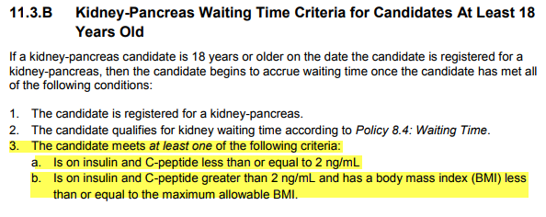
Proposed Solution:
Remove the BMI/insulin requirement from KP waiting time criteria (highlighted portion below) and references to max BMI
Notes:
We propose addressing the problem by removing the KP waiting time criterion and references to a maximum allowable BMI. By removing the KP waiting time criterion, Type 1 and Type 2 diabetic candidates with high BMIs will be treated equally in their ability to accrue waiting time.
It is important to note that candidates still need to be diagnosed with diabetes or have pancreatic exocrine insufficiency with renal insufficiency in order to register for a KP transplant.

Slide 12
Other reasons to choose this solution?
Allows discretion of transplant team
Programs are already reviewed for outcomes – don’t need additional restriction
Encourages KP transplantation and utilization of pancreata
Removes burden of reviewing maximum every six months
Reviewing max BMI every 6 months generates confusion in community
Notes:
In addition to the reasons listed previously, here are some other factors that make this solution the best to address the problem:
It allows discretion of the transplant team. Even if a program determines that a candidate is appropriate for transplant, that candidate may not be able to accrue waiting time. Because waiting time is an important part of allocation process, lack of waiting time can impact access to transplant for candidates.
Programs are already reviewed on kidney graft and patient outcomes, and starting in February they will also be reviewed on pancreas graft outcomes. This motivates the program to be selective in choosing candidates for transplant, which means an additional waiting time restriction on candidates that programs have already identified as appropriate for transplant is unnecessary.
Changing KP waiting time criteria aligns with the first OPTN strategic goal to increase the number of transplants. In 2015, 25% of pancreata recovered for transplant were discarded. By enhancing access for candidates currently prevented from accruing waiting time, this proposal may reduce the pancreas discard rate and increase the total number of KP transplants.
It removes the burden of reviewing the maximum BMI every six months
Finally, it may bring clarity to the waiting time criteria, since reviewing max BMI every 6 months generates confusion in the community about what the current policy is

Slide 13
How will members implement this proposal?
Transplant hospitals need to educate staff on the policy change
Staff need to be aware of changes to KP waiting time criteria, as this will affect their procedures regarding candidate recruitment
Notes:
Implementing this proposal will be easy for members. Transplant hospitals need to educate staff on the policy change, and staff need to be aware of changes to KP waiting time criteria since this affects their candidate recruitment process.

Slide 14
How will the OPTN implement this proposal?
Anticipated Board Review date: June, 2018
Programming in UNetSM
Modifications to managing kidney-pancreas registrations in WaitlistSM
Waiting time that would have been accrued will be granted to candidates newly eligible for KP waiting time
Site surveys would no longer review insulin, C-peptide and BMI criteria for KP candidates
Post-implementation, committee will evaluate:
Trends in Type 1 and Type 2 KP candidates/recipients
Post-transplant outcomes for patient, pancreas graft, kidney graft survival stratified by diabetes type, BMI and ethnicity
Notes:
This proposal is out for public comment January through March 2018 and is slated to go to the Board in June. It will require programming in Unet for modifications to managing kidney-pancreas registrations in Waitlist. Additionally, any candidates newly eligible for KP waiting time will be granted waiting time that would have been accrued when they were listed (waiting time will be back-dated).
Any site surveys will no longer review for this criterion. Post implementation, we will evaluate trends in KP candidates and recipients by diabetes type. We will also evaluate post-transplant outcomes for patient, pancreas graft, and kidney graft survival stratified by diabetes type, BMI and ethnicity.

Slide 15
Questions?
Jon Odorico, MD
Pancreas Transplantation Committee Chair
jon@surgery.wisc.edu
Abigail Fox, MPA
Pancreas Transplantation Committee Liaison
Abigail.fox@unos.org

Slide 16
Extra Slides

Slide 17
Alternative Solutions Considered
Change the cap to a number – e.g., 32 or 36 …
PROS: would captures most of the candidates being transplanted but keeps a cap in place
CONS: Number still arbitrary and removes discretion from transplant team
Remove BMI cap but keep table that allows only up to 15% T2
PROS: imposes limit without specifying cap
CONS: May result in no change to maximum allowable BMI if T2 is close to 10%, meaning BMI would stay at 30
Still an artificial limitation that removes discretion and limits access to transplant
Requires continual reassessment and updating policy to reflect the correct level

Slide 18
UNOS Research Analysis:
Compared SPK candidates/recipients who met KP waiting time criteria with those who didn’t meet criteria for:
Waitlist mortality
Recipients for Post-transplant outcomes
Compared T1, T2 SPK candidates/recipients for:
Waitlist mortality
Post-transplant outcomes
Notes:
Cohorts:
n = 2479 post-implementation era (2014-2016)
n = 13853 for larger sample size (2006-2016)
The larger cohort is used for the T1, T2 comparisons. By design, comparing candidates based on whether they met KP waiting time criteria meant that the cohort only goes back to 2014, post-implementation.

Slide 19
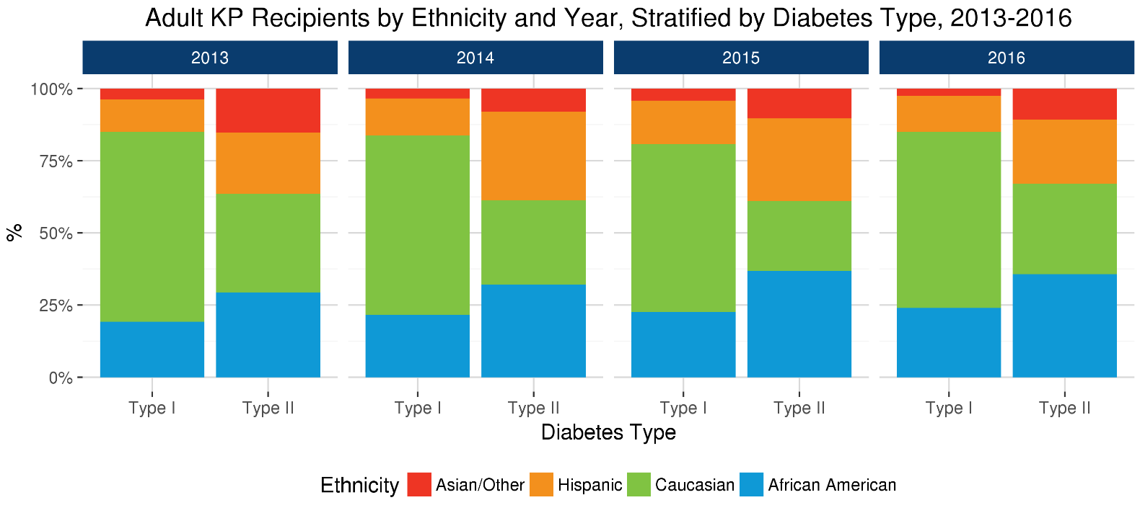
Populations impacted by proposal
Notes:
Shows that minority populations are a larger proportion of Type 2 than Type 1 recipients:
This slide shows that the proportion of minority KP recipients is greater for Type 2 from 2013 to 2016. Because the KP waiting time criterion limits access to transplant for Type 2 candidates with C-peptide > 2 ng/mL, a population that is more highly represented by minority populations, removing this restriction would improve equity in access to transplant by ethnicity.

Slide 20
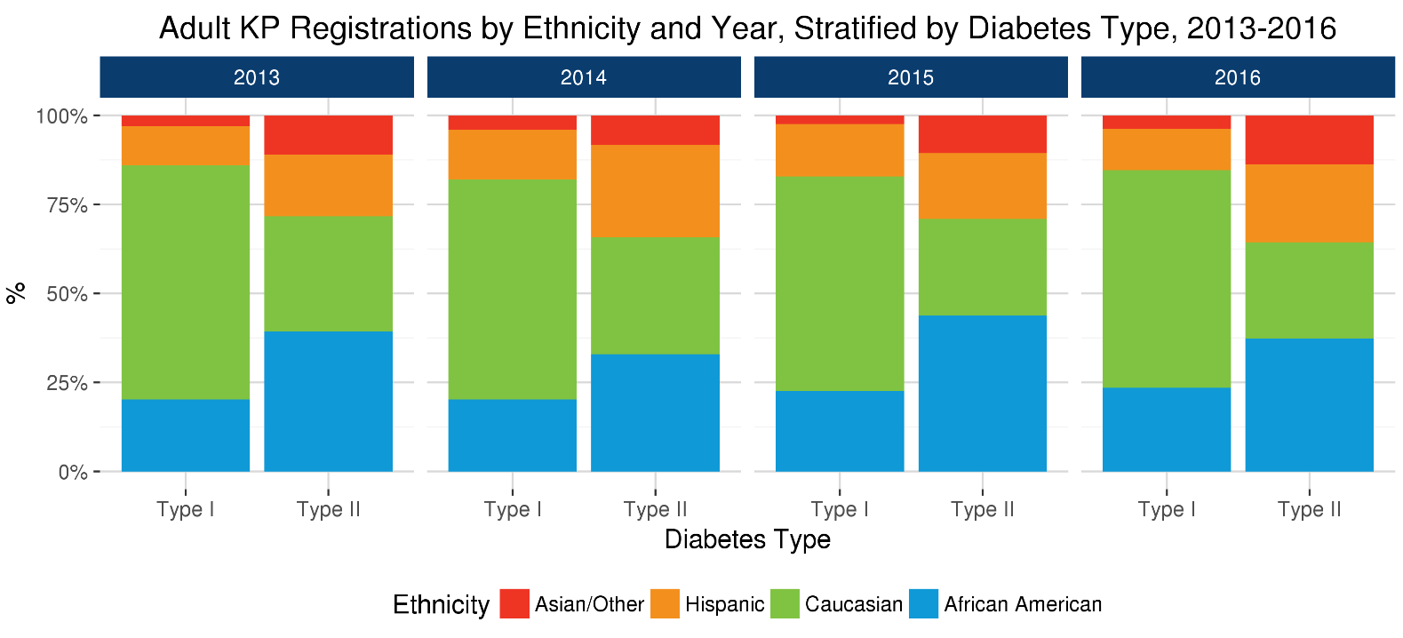
Populations impacted by proposal
Notes:
Shows that minority populations are a larger proportion of Type 2 than Type 1 registrations:
This proposal would increase access for minority populations who represent a larger proportion of Type 2 diabetic KP candidates and recipients. African Americans represented 37.3% of Type 2 adult KP candidates but only 23.4% of Type 1 adult KP candidates in 2016. Latinos represented 21.8% of Type 2 adult KP candidates and 11.6% of Type 1 adult KP candidates. Asian and other ethnicities represented 13.8% of Type 2 Adult KP candidates and only 3.8% of Type 1 adult KP candidates for 2016. By contrast, Caucasians were over-represented as Type 1 KP candidates: in 2016, Caucasians represented 27% of the Type 2 KP candidates and 61.2% of the Type 1 candidates. These trends are seen for adult KP recipients as well. When stratified by BMI, UNOS data also shows Caucasians under represented for moderately obese (BMI = 25-30) and obese (BMI > 30) Type 2 candidates. Figure 5 shows that minority populations represent a greater proportion of Type 2 candidates when compared to Type 1 candidates for KP.

Slide 21
Notes:
Type 2 showed similar outcomes as Type 1: After adjustment for other risk factors, SPK recipients with type 2 diabetes diagnosis were not at increased risk for death, kidney failure, or pancreas failure when compared with recipients with type 1 diabetes. However, BMI of 25-30 and above 30 (vs 18.5-25) of the recipient associated with pancreas graft failure.
This paper casts doubt on the claim that Type 1 recipients have better outcomes than Type 2 recipients.

Slide 22
Notes:
Type 1 high BMI may have elevated risk: This study is for Type 1 Diabetics with high BMIs. Because Type 1 Diabetics have low c-peptide, they can have a high BMI and still get transplanted. This highlights that the current KP waiting time criterion restricting access for Type 2 candidates is arbitrary.

Slide 23
Insulin Usage
Rarely, some KP candidates are insulin-free
However, evidence suggests they can still benefit
Typically these candidates were on insulin but had to come off it while waiting for a kidney transplant
Once they get a kidney transplant, they’ll need insulin again
Therefore, an SPK or PAK transplant may be the appropriate option
The Committee supported removing this aspect of the KP waiting time criteria
Notes:
The KP waiting time criterion removed by this policy change also removes the requirement that KP candidates be on insulin to accrue waiting time. Similarly to high BMI Type 2 KP candidates, KP candidates with no insulin usage are rarely transplanted. However, there is evidence that these candidates need an SPK or PAK transplant and would benefit from it. Typically these candidates were on insulin but came off it due to complications with renal failure. Once they get a kidney transplant, they’re likely to need insulin again, and so may be appropriate for an SPK or PAK transplant. Because removing the restriction to accrue waiting time for KP candidates not on insulin restores discretion to the transplant team in deciding which candidates would best benefit from transplant, the Committee supported removing this waiting time criterion as well.

