Slide 1
Review Board Guidance for Hypertrophic and Restrictive Cardiomyopathy Exception Requests
Thoracic Organ Transplantation Committee

Slide 2
What problem will the proposal solve?
Concern from community that hypertrophic cardiomyopathy (HCM) and restrictive cardiomyopathy (RCM) candidates may be disadvantaged in new heart allocation system
HCM/RCM physiology may not benefit from mechanical circulatory support devices (MCSDs), and the higher statuses are device driven
A lack of uniform expertise in their physiology results in variability in Regional Review Board decisions across the country
Objectively quantifying the severity of illness is challenging
Notes:
At its Dec. 2016 meeting, the OPTN/UNOS Board of Directors approved the Thoracic Committee’s proposal to Modify the Adult Heart Allocation System. While developing the proposal, the Committee received feedback from the heart transplant community about concerns that hypertrophic cardiomyopathy (HCM) and restrictive cardiomyopathy (RCM) candidates may be disadvantaged by the proposed policy for these reasons:
HCM/RCM physiology may not benefit from mechanical circulatory support devices (MCSDs), and the higher statuses are device driven
A lack of uniform expertise in HCM/RCM physiology results in variability in Regional Review Board (RRB) decisions across the country
Objectively quantifying the severity of illness is challenging
Improved data collection required by the new heart policy should help us better assess whether specific subpopulations of HCM/RCM are disadvantaged by the status 4 assignment. It could also result in future policy changes to address any disadvantages.
The exception and review process will accommodate these candidates. The Committee recognized that HCM/RCM expertise may be inconsistent across the review boards. This could make evaluating and awarding HCM/RCM exception requests vulnerable to variability.

Slide 3
What are the proposed solutions?
Guidance for the RRBs that outlining objective criteria to standardize the evaluation and decision-making of HCM/RCM exception requests
Guidance provides:
Guidelines about which statuses would be appropriate for specific conditions
Rationale and context that justify the recommendations to help review boards without an HCM/RCM expert
Objective criteria review boards can use to evaluate exception requests, potentially increasing standardized decision-making
Notes:
To help mitigate these potential inconsistencies, the Committee created guidance for the review boards. They can use this objective criteria to standardize how they evaluate and make decisions about HCM/RCM exception requests.

Slide 4
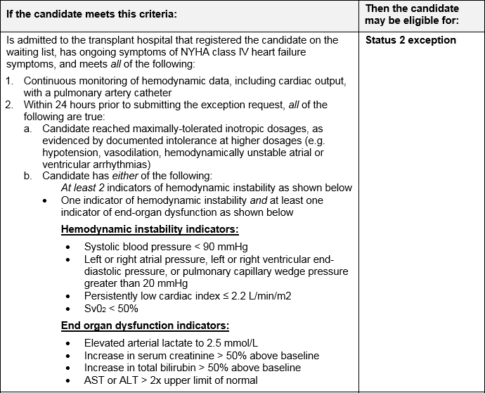
Table 1: Recommended criteria for HCM/RCM status exceptions
Notes:
This table shows the recommended criteria for HCM/RCM status exceptions.

Slide 5
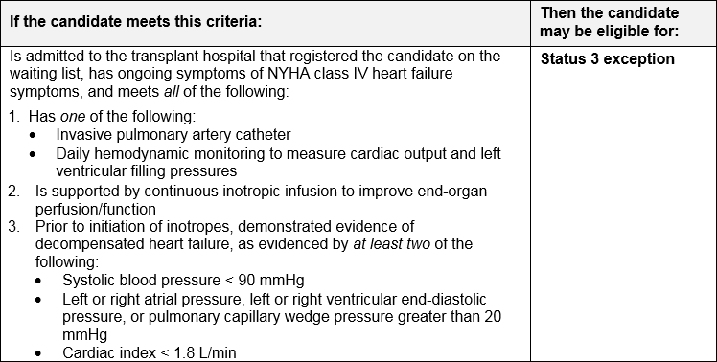
Table 1: Recommended criteria for HCM/RCM status exceptions
Notes:
This table shows the rest of the recommended criteria for HCM/RCM status exceptions.

Slide 6
How will members implement this proposal?
RRB members should consult this resource when assessing exception requests
Heart programs can consider guidance when submitting exception requests for HCM/RCM candidates
Guidance only, not mandatory
Notes:
Since this is a guidance document, it is not required for members to follow the information contained in the guidance. The guidance document can serve as a resource for review board members when assessing exception requests. Heart programs can also consider guidance when submitting exception requests for HCM/RCM candidates.

Slide 7
How will the OPTN implement this proposal?
June 2018 – Board of Directors meeting
Implemented along with pending heart policy
HCM/RCM patients and any exceptions will be monitored with other exception requests
Notes:
We project that the Board of Directors will consider this proposal in June 2018. This guidance will be part of the pending heart policy implementation, and will be available on the OPTN site. Since it is guidance, no monitoring is necessary, although HCM/RCM patients and all exceptions will be monitored as part of the pending heart policy.

Slide 8
Questions?
Kevin Chan, MD
Committee Chair
kevichan@med.umich.edu
Kimberly Uccellini, MS, MPH
Committee Liaison
Kimberly.Uccellini@unos.org

