Slide 1
Modification of the Lung Transplant Follow-up Form (TRF) to Better Characterize Longitudinal Change in Lung Function following Transplantation
Thoracic Organ Transplantation Committee

Slide 2
What problem will the proposal solve?
Current Transplant Recipient Follow-up (TRF) form only collects data on bronchiolitis obliterans syndrome (BOS)
Limited data does not capture all the prognosis possibilities for declining graft function
Notes:
The current OPTN/UNOS adult and pediatric lung and heart-lung Transplant Recipient Follow-up form (TRF) collects lung graft function status limited to bronchiolitis obliterans syndrome. The Thoracic Committee identified two issues with the way graft function data is collected on the TRF, which limits the utility of this data in the context of chronic lung rejection:
BOS data collection is outdated, incomplete, and inaccurate
Restrictive allograft syndrome (RAS) is not collected at all
The limited data currently collected does not capture all the prognosis possibilities for declining graft function and may not accurately describe the type of rejection a patient is exhibiting. Chronic lung allograft dysfunction (CLAD) is a broader, more contemporary definition of post-transplant lung dysfunction, encompassing both obstructive and restrictive chronic lung rejection. This proposal will modify the adult and pediatric lung and heart-lung TRF forms to align with updated professional definitions. Refining the outcomes data the OPTN collects can better inform future policy.

Slide 3
What are the proposed solutions?
Modify current FEV1 field and add Forced Vital Capacity (FVC) and Forced Expiratory Flow 25–75% (FEF 25–75) fields
Collected at three time intervals per TRF
Modify Bronchial Stricture and Oxygen Requirement fields
Bronchial Stricture: 6 month and 1-5 year TRFs
O2 Requirement: at rest and with exercise
Notes:
The Committee and ultimately decided to add fields to the TRFs for FVC and FEF 25-75, and to modify the current FEV1 field. These will be collected at three time intervals per TRF (you will see an example of what this may look like in the next slide).
The Committee is also proposing to modify the current bronchial stricture field and the O2 requirement field. For bronchial stricture, the Committee proposes including it on the 6 month and 1-5 year TRFs, but is seeking feedback from the community on ways to improve the wording of question for the data element. The Committee believes that the current response choices for the question “Bronchial Stricture (since last follow up)” of “Yes, No, or Unknown” may not be the best choices for this condition. For the O2 requirement field, the Committee agreed that better data could be gathered if the question was clarified. The proposed change is to have a field for “O2 requirement at rest” and another for “O2 requirement with exercise”
The elements selected are objective and standardized. They are easily accessible within a patient’s medical record for both clinical and non-clinical coordinators and no interpretation is necessary. This format should improve the accuracy and completeness of reporting. In addition, the modifications to the TRF allow for collection of a new phenotype of chronic lung rejection.

Slide 4
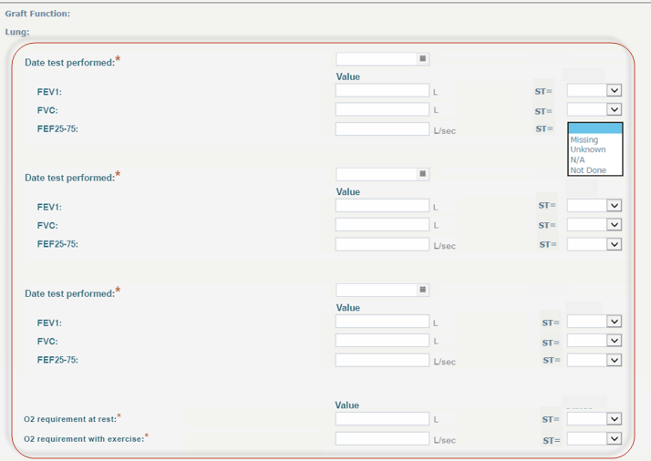
What are the proposed solutions?
Notes:
The UNOS IT Department created this mock up of what a TRF could look like. Keep in mind that this is just a mock-up, and not what the final TRF will look like if implemented. Note that there are three intervals for Date Test Performed, which the Committee suggests be collected at three equally spread out time points during the TRF time period. The Committee welcomes feedback about these time intervals.

Slide 5
What are the proposed solutions?
Element | Current form | 6 month form | 1-5 TRF | 6+ TRF | Interim Forms (Death/Graft Failure)
FEV 1 | Yes | Yes-modified | Yes- modified | Yes-modified | Yes
FVC | No | Yes- New | Yes- New | Yes- New | Yes
FEF 25-75 | No | Yes- New | Yes- New | Yes- New | Yes
Bronchial stricture | Yes | Yes-modified | Yes- modified | No
Oxygen requirement | Yes | Yes-modified | Yes- modified | Yes-modified
Notes:
The table shows each data element, whether it is on the current TRF, and its status on the each proposed TRF. Note that there are only two entirely new fields – FVC and FEF25-75, but these are easily accessible already from a patient’s record.
(In case anyone asks, Bronchial Stricture and O2 Requirement not asked on interim forms partially due to having the highest rate of missing values across all TRFs)

Slide 6
How will members implement this proposal?
Transplant Hospitals: provide new graft function data
New data elements are standard measures (part of pulmonary function test) readily available
Possible minimal staff training
Notes:
Transplant hospital members will be affected by this proposal. Transplant programs will be required to provide new graft function data to the OPTN for all adult and pediatric lung and heart-lung transplant recipients on the relevant TRF. Administrative burden is mitigated by the fact that the new data elements are standard measures obtained during PFT and readily obtainable to both clinical and non-clinical data coordinators in medical records. Minimal staff training may be required.

Slide 7
How will the OPTN implement this proposal?
June 2018 – Board of Directors meeting
Programming of TIEDI forms
Instructional effort may be needed
No changes to monitoring plan
Any data entered in UNetSM is subject to OPTN review
Notes:
This proposal is projected to go to the Board of Directors in June of 2018. If approved, this proposal will require an additional public comment posted in the Federal Register sponsored by the Health Resources and Services Administration (HRSA) to adhere to the Office of Management and Budget’s guidelines for collecting additional information. This proposal requires programming in UNet as it involves modifying TIEDI forms. We’ll modify The 6-month, 1-5 year, and 6+ year TRF forms for both adult and pediatric lung and heart-lung and we’ll also change the interim forms.
This proposal may require an instructional program and will be monitored for specific needs throughout development and implementation to determine exactly what members need to know.
The changes to the data elements in this proposal do not affect the monitoring plan. Any data entered in UNet may be subject to OPTN review, and members are required to provide documentation as requested.

Slide 8
Feedback
The Committee is proposing keeping the bronchial stricture question on the 6-month and 1-5 year TRFs. Does the community feel this question is of value? If so, please provide input on how the question could be better asked to elicit more meaningful data regarding this short-term complication. If not, please articulate why.
The Committee welcomes feedback on how many time intervals should be collected for FEV1, FVC, and FEF 25-75.
Members are asked to comment on both the immediate and long term budgetary impact of resources that may be required if this proposal is approved. This information assists the Board in considering the proposal and its impact on the community.
Notes:
The Committee is asking for feedback on these three questions: whether or not to keep the bronchial stricture question on the 6 month and 1-5 year TRFs, how many time intervals should be collected for FEV1, FVC, and FEF25-75, and about budgetary impact of this proposal.

Slide 9
Questions?
Kevin Chan, MD
Committee Chair
kevichan@med.umich.edu
Kimberly Uccellini, MS, MPH
Committee Liaison
Kimberly.Uccellini@unos.org

Slide 10
Extra Slides

Slide 11
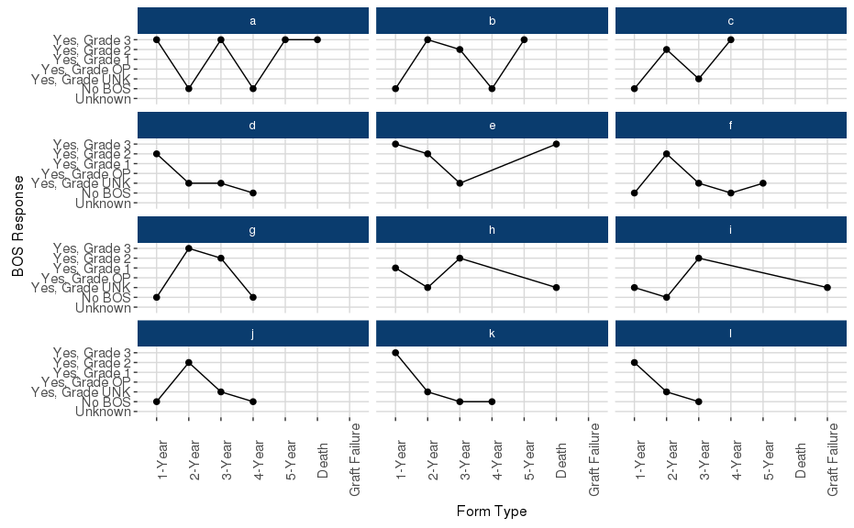
Supporting Evidence
Data showed inconsistent reporting for BOS on current TRF.
Notes:
The Subcommittee looked at OPTN data on BOS reporting, Bronchial Stricture data completeness, and O2 Requirement Data Completeness.
The BOS data illustrated the inconsistency in data reporting for BOS on the current TRF. The evidence shown in the analysis of these randomly selected individuals (BG) supports the claim that the current subjective criteria that is collected on the TRF using the BOS field does not always adequately represent the staging of rejection in lung transplants. Trends shown in this report indicate that centers likely do not see the progression through BOS stages the same way, and the data is not collected consistently within each center or patient year to year.

Slide 12
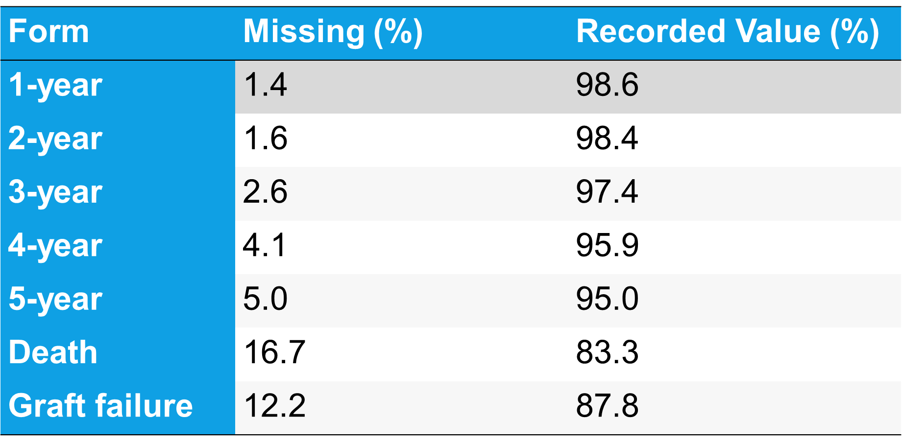
Supporting Evidence
Bronchial Stricture Data Completeness
Notes:
For bronchial stricture reporting, data showed a gradual increase in missing values and therefore a decrease in reported values across the year 1-5 TRFs. A majority of responses for this question were “no,” with a higher percentage of affirmative responses reported on the 1-year TRF and a decreasing trend over time. Bronchial stricture reporting dropped noticeably at the time of reporting death or graft failure.

Slide 13
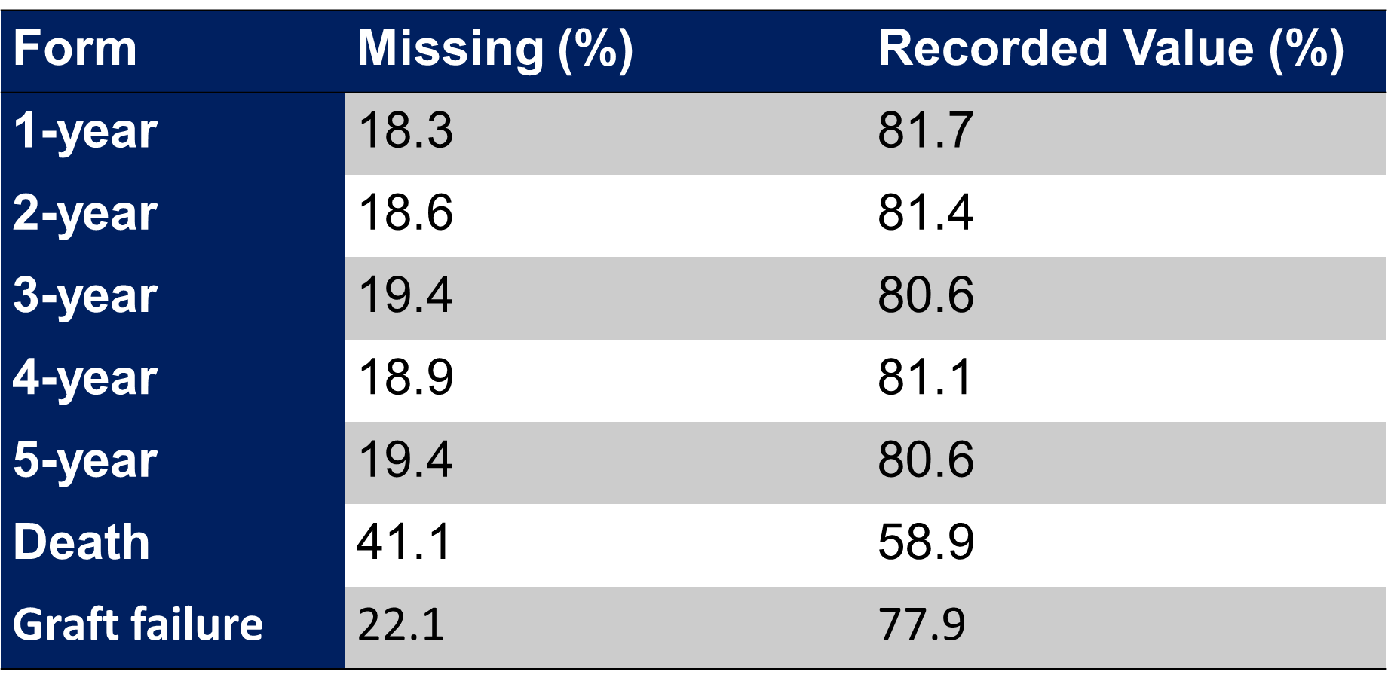
Supporting Evidence
O2 at Rest Data Completeness
Notes:
For O2 requirement at rest, data showed that within 5-years of transplant for all adult lung alone transplants 2009-2015, approximately 20% of values were missing.
The Subcommittee felt that all of this evidence supported efforts for more precise data collection focused on objective data fields, including FEV1 and FVC.

