Slide 1
OPTN/UNOS Kidney Transplantation Committee
Spring 2018 Update
Notes:
Hi, my name is ______ and I am the region ___ representative for the Kidney Committee. I’m going to give you a short update about what the Committee has been working on and what we hope to work on in 2018 and beyond.

Slide 2
Policy Implementation Plans
Kidney policy changes tentatively scheduled to start programming in Q3 2018:
Improving En Bloc Kidney Allocation
Improving Dual Kidney Allocation
Notes:
We do not currently have any public comment proposals out for review but the Committee is excited about what is coming down the line for IT implementation.
The Improving En Bloc Kidney Allocation and Improving Dual Kidney Allocation policy changes were approved at the most recent Board meeting in December 2017. They are tentatively scheduled to start programming in Q3 2018. These policy changes will be paired with plenty of communication and instructional offerings.

Slide 3
Allowing Deceased Donor-Initiated KPD Chains
Donor Loss
Strong concerns over candidate transplant occurring first
Equity & Access
Disadvantaging populations: Strong concern for ABO-O, racial/ethnic minorities, those less likely to have a living donor
Model Preference
Depletion of ABO-O candidates
Concerns expressed about all models – no clear “winner”
Several comments supportive of proposal but neutral on approach
Notes:
The Kidney Committee released a concept paper with three models for allowing deceased donors to initiate KPD chains for public comment in Fall 2017. It received the second most number of public comments for that cycle.
The community was generally supportive of the project moving forward but there were concerns around some of the models. The main concerns revolve around donor loss, disadvantaging other populations, and the ethical implications of taking a deceased donor kidney from the match run.

Slide 4
Allowing Deceased Donor-Initiated KPD Chains
Identify parameters for chosen model
SRTR optimization analysis
2nd concept paper for community feedback
Notes:
The Deceased Donor Chains Workgroup is currently discussing how to take that community feedback and move forward.
The WG will first identify parameters for the chosen model, such as what kind of deceased donor kidneys would be eligible and what kind of candidates would be eligible.
The WG are in discussions with SRTR for optimization analysis that will help define constraints and effects of the change on the current system.
Then the WG wants to send out a more detailed concept paper for community feedback before proceeding to a definitive policy proposal.

Slide 5
KAS 2-Year Review-Inspired Projects
Key goals of KAS:
Make better use of available kidneys
Increase transplant opportunities for difficult-to-match patients
Increase fairness by awarding waiting time points based on dialysis start date
Have minimal impact on most candidates
Two areas of community and Committee concerns:
Access for the very highly sensitized candidates
Perceived impact on pediatric transplantation rates
Notes:
The KAS 2-year report proved that KAS was successful in many key goals, but there were community concerns and opportunities for improvement.
The Kidney Committee has identified two equity and access areas of concern: access for very highly sensitized candidates and the perceived impact on post-KAS pediatric transplantation rates that they wish to investigate further. After Executive Committee approval, the Committee is moving forward with 2 workgroups to address these concerns and investigate solutions.

Slide 6
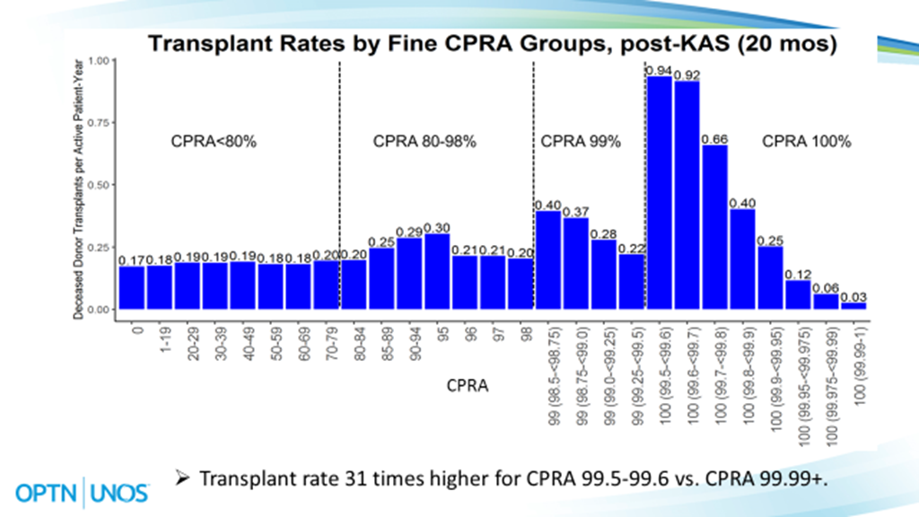
Notes:
Currently under KAS, candidates with a high CPRA score (80-100%) are being transplanted at vastly different rates and those “true” 100% CPRA candidates are waiting significantly longer for organ offers. Post-KAS analyses suggested transplant access for very highly sensitized patients may vary sharply depending on the precise CPRA value. The Committee would like to investigate high CPRA sliding scale solutions to mitigate the inequity of organ offers and transplant rates in highly sensitized kidney candidates.
Looking at the figure in the slide, for patients with CPRA 99.5-99.6%, rates of receiving offers and transplants were 57 and 31 times higher than for CPRA 99.99%+ patients.
CITATION INFO: Stewart D, Kucheryavaya A, Tyan D, Gebel H, Bray R, Turgeon N. Even with National Sharing, the Prospects of a 100% Sensitized Patient Receiving a Transplant Vary Dramatically Depending on the Precise CPRA Value. Am J Transplant. 2017;17 (suppl 3).

Slide 7
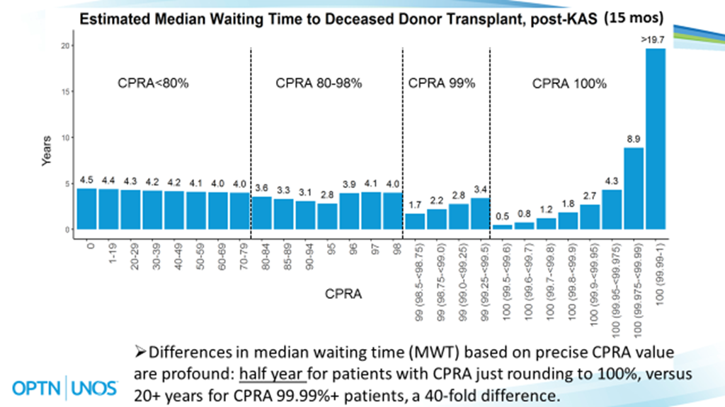
Notes:
On average, CPRA 99.99%+ patients are expected to receive just one offer every 10 years and have estimated median waiting time of greater than 19.7 years, 40 times longer than the 6-month estimated median waiting times for CPRA 99.5-99.6% patients.
CITATION INFO: Stewart D, Kucheryavaya A, Tyan D, Gebel H, Bray R, Turgeon N. Even with National Sharing, the Prospects of a 100% Sensitized Patient Receiving a Transplant Vary Dramatically Depending on the Precise CPRA Value. Am J Transplant. 2017;17 (suppl 3).

Slide 8
Improving Access for Pediatric Kidney Candidates
Are pediatric kidney candidates prioritized enough in KAS, given the increased priority of other candidate populations?
Pre-KAS | Post-KAS
463 pediatric transplants nationwide | 461 pediatric transplants nationwide
4.2% of deceased donor kidney transplants going to pediatrics | 3.7% of deceased donor kidney transplants going to pediatrics
WL representation 0.9% (984) | WL representation 0.9% (1018)
Pediatric rate of transplantation remains 4 times higher than adults
Post-KAS, regions 5, 7, 10 and 11 had a decrease in pediatric transplants, while regions 1 and 8 saw increases
Notes:
It is true that under the new kidney allocation system (KAS), some highly sensitized patients are now given the highest priority on the waiting list, ahead of most pediatric candidates. Kidneys with a KDPI of less than or equal to 20% are going to highly sensitized, 0 mismatch, and prior living donors before being offered to local pediatrics. The Committee wants to investigate if pediatric candidates are prioritized enough in KAS, given the increased priority of other population groups.
The overall number of deceased donor kidney transplants going to pediatric patients has remained virtually unchanged pre vs. post KAS.
463 pediatric transplants nationwide the year before KAS
461 pediatric transplants nationwide during year 2 post-KAS (Dec 4, 2015 – Dec 3, 2016)
The percentage of deceased donor kidney transplants going to pediatrics has declined from 4.2% to 3.7%, indicating that pediatrics have not benefited as much as adults from the increasing trend in deceased kidney donation.
The percentage of waitlist representation for pediatrics post-KAS remained stable at 0.9%.
Since pediatrics still maintain priority over most adults, the pediatric rate of transplantation remains 4 times higher than adults. Waiting times for pediatrics have changed little pre vs. post-KAS and remain shorter than extremely highly sensitized adults.
The geographic distribution of pediatric kidney transplants had mixed results. Post-KAS, most regions had higher or similar percent of pediatric transplants Year 2 vs. Year 1 post-KAS; regions 5, 7, 10 and 11 had a decrease in pediatric transplants, while regions 1 and 8 saw increases.

Slide 9
Project Work Group Tentative Timeline
Project Approval
2/2018
SRTR Modeling
Early 2019
Public Comment
Fall 2019
Concept Paper
Fall 2018
Notes:
The Kidney Committee wants the Improving Access for Highly Sensitized and Pediatric Kidney Candidates project to move quickly and gather community feedback along the way.
The project is seeking Policy Oversight and Executive Committee approval in February 2018.
Our goal is to gauge initial community feedback about highly sensitized and pediatric candidates within the allocation prior to developing a policy proposal.
After gathering community feedback, various solutions will be modeled by the SRTR for impact.
SRTR data will assist in developing a public comment proposal.

Slide 10
Questions?
Nicole Turgeon, MD
Kidney Committee Chair
nturgeo@emory.edu
Chad Southward
Kidney Committee Liaison
chad.southward@unos.org
Notes:
If you have any questions after today’s regional meeting, please contact your RA. You can also contact Nicole Turgeon, the Chair of the Kidney Committee, or Chad Southward, Kidney Committee liaison.

Slide 11
Kidney Committee Update Extra Slides
Only use as necessary or if helps answer questions

Slide 12
En Bloc Kidney Summary Points
Solution establishes en bloc policy with:
Mandatory en bloc allocation based on donor weight
Allocation of en bloc kidneys based on KDPI 0-20% (Sequence A)
Option to split en bloc kidneys at surgeon’s discretion
Notes:
Currently, OPTN policy does not specify how an OPO should allocate en bloc kidneys, or which kidneys qualify for en bloc allocation. As a result, kidneys are often offered as en blocs late, or not recovered at all. Approximately two percent of all kidney transplants are en bloc transplants.
First, allocation of en bloc kidneys will be based on donor weight. This donor characteristic is readily available prior to organ recovery and is a significant predictor of organ recovery from small pediatric donors.
Second, en bloc kidneys will be allocated based on a deceased donor KDPI of less than or equal to 20%. Recent studies have found that en bloc kidneys have graft survival outcomes comparable to an ideal deceased or living donor.
Finally, it will be permissible for surgeons to split en bloc kidneys if they determine they can be single transplants into two recipients.

Slide 13
En Bloc Kidney Summary Points
DonorNet® overestimates KDPI score for en bloc kidneys, potentially screening medically suitable candidates off the match run
Solution to mask KDPI score in en bloc kidney allocation
DonorNet ® has communication limitations
Solution mandates that centers must report to UNOS that they are willing to accept en bloc kidneys at the candidate level in order to receive en bloc offers
Notes:
DonorNet also overestimates the KDPI score for en bloc kidneys. The current KDPI scoring does not reflect graft failure risk for kidneys transplanted en bloc, since the KDPI score assumes each kidney will be transplanted as a single kidney and does not account for the survival advantage associated with en bloc use. The Committee opted to mask the KDPI value in DonorNet on the match offer, which will prevent candidates from being screened off the match run for high KDPI kidneys.
In addition, DonorNet currently does not enable an OPO to indicate when it is offering en bloc kidneys, nor does it require transplant centers to indicate that they accept and transplant kidneys en bloc.
This proposal requires transplant centers to report to UNOS that they are willing to accept en bloc kidneys offers at the candidate level.

Slide 14
Dual Kidney Summary Points
Sequence C KDPI 35-84% | Sequence D KDPI > 85%
Highly Sensitized 0-ABDRmm Prior living donor Local SLK safety net Local Regional National Local (Dual Opt-In) Regional (Dual Opt-In) National (Dual Opt-In) | Highly Sensitized 0-ABDRmm Local SLK safety net Local + Regional Local Local (Dual Opt-In) Regional Regional (Dual Opt-In) National National (Dual Opt-In)
Sequences C & D include single and dual opt-in allocation
Combined Local + Regional classification removed
Notes:
The allocation sequences for kidneys with KDPIs 35% and above have been amended to include single and dual allocation, and the combined Local + Regional classification has been removed. These amendments should ensure that the kidneys at increased risk for discard are offered earlier to the nearest center that will use them. This policy provides OPOs with concrete direction on how to allocate high KDPI kidneys, allowing them to make offers much more quickly, and allows a transplant program to list a candidate to receive offers for both single and dual kidneys on the same match run.

Slide 15
Overview: Three Potential Methods of Initiating KPD Exchanges with Deceased Donor Kidneys

Slide 16
Carl & Dinah’s Candidate- Driven KPD Chains Step by step
First…
Carl and Dinah consent to participate in a deceased donor chain
Carl is registered on the Waitlist. He receives elevated priority due to the pair’s willingness to participate in an chain
Then…
After Carl is transplanted, Dinah’s KPD program conducts a match run for her kidney
Dinah donates her kidney, continuing the deceased donor chain
Carl receives a deceased donor kidney offer, he accepts, and is transplanted
The donor at the end of the chain donates to the Waitlist or bridges to continue the chain
Notes:
In Candidate Driven DD chains the candidate and the paired donor – in this case, Carl and Dinah –consent to Carl receiving a deceased donor kidney transplant in exchange for Dinah donating in KPD. Once they’ve done so, Carl receives additional priority on the deceased donor Waitlist for a kidney. A deceased donor kidney is offered to Carl and if he accepts, he is transplanted. It is not until after Carl is transplanted that Dinah’s KPD program activates her in a match run. Once they do so, Dinah is matched and continues the chain that started with the deceased donor. The donor at the end of the chain either donates to the waitlist or continues the chain in another match run as a bridge donor.

Slide 17
Carl & Dinah’s List Exchange KPD Chain Step by step
First…
Carl and Dinah consent to participate in a list exchange chain.
Dinah enters a KPD program and starts an exchange
Then…
After Dinah donates, Carl receives increased priority on the Waitlist
Carl is offered a deceased donor kidney
The end of the exchange donates to the Waitlist or starts another exchange
Carl accepts the kidney and is transplanted
Notes:
In list exchange chains after both Carl and Dinah consent to participation, Dinah donates her kidney to initiate a KPD chain first, instead of just donating to the waitlist, as in a traditional list exchange. The chain continues until the donor at the end either donates to the Waitlist or bridges to continue the chain. It is not until after Dinah donates that Carl receives increased Waitlist priority, is offered a kidney and transplanted. So you can see this model is the reverse of the candidate driven system in which Carl receives a Waitlist priority and a transplant prior to Dinah donating. Carl does not have to wait until the chain is complete to receives his Waitlist priority, he just need to wait until Dinah donates

Slide 18
Carl & Dinah’s Donor-Driven DD Chains
First…
Then…
After Carl is transplanted, Dinah donates her kidney, continuing the KPD chain
Carl is matched with the deceased donor kidney, accepts the offer and is transplanted
The donor at the end of the chain donates to the Waitlist or bridges to continue the chain
Then…
Carl and Dinah consent to participate in a KPD exchange
A deceased donor kidney is redirected from Waitlist allocation to a KPD program
Notes:
The first step in donor-driven chains as in all these systems is for Carl and Dinah to consent for Carl to receive a DD kidney in exchange for Dinah donating her kidney. Meanwhile, a deceased donor is identified by an OPO and one kidney is redirected from Waitlist allocation to a KPD program. Carl, registered as a KPD participant in conjunction with Dinah, is a match with this kidney. He accepts the offer and is transplanted. Dinah is in the same KPD match run as Carl, but does not donate until after Carl is transplanted. The chain continues until the last donor either donates to the waitlist or bridges to continue the chain in another match run

Slide 19
CPRA 99-100% Recipient “Bolus Effect”
Percent of Transplants to CPRA 99−100% Recipients
20
17.7%
15.7%
15.4%
15
14.6%
13.4%
13.4%
KAS Implementation
12.6%
12.2%
12.4%
12.3%
11.7%
11.8%
11.9%
11.2%
10.6% 10.5%
10.2% 10.1%
_{9.7% 9.5%} 9.9% _{9.6% 9.7%} 10.0%
10.1%
9.6%
10
5
3.2%
2.9%
3.5%
2.9%
2.5% ^{2.8%} 2.4%
1.8%
2.3% _{2.0%}
1.8%
1.6%
0
Feb−2014 May−2014 Aug−2014 Nov−2014 Feb−2015 May−2015 Aug−2015 Nov−2015 Feb−2016 May−2016 Aug−2016 Nov−2016 Feb−2017
Transplant Date
Transplants to CPRA 99−100% patients rose sharply after KAS but have tapered to around 10%.
Notes:
Transplants to CPRA 99−100% patients rose sharply after KAS but have tapered to around 10% for the past year, remaining relatively stable here.

Slide 20
Geographic Distribution of Pediatric Kidney Transplants
Pre−KAS Post−KAS Year 1 Post−KAS Year 2
50%
40%
30%
21.2%
20%
16.8% _{15.8%} 16.7%
^{16.0%} 15.6%
13.2%
14.7% 15.0%
10%
9.9% 9.8%
10.0%
9.5% 9.5%
5.9%
7.6%
7.4%
_{7.1%} 7.7%
7.6% 7.7% _{6.5%}
6.1%
4.1%
_{3.4%} 3.9%
2.2%
5.6%
5.6%
5.2% 5.0% 5.0%
2.9%
0%
1
2
3
4
5
6
OPTN Region
7
8
9
10
11
Post−KAS, most regions had higher or similar percent of pediatric transplants Year 2 vs. Year 1; regions 7, 10, and 11 had a decrease in pediatric transplants, while regions 1 and 8 saw increases.
Notes:
Post−KAS, most regions had higher or similar percent of pediatric transplants Year 2 vs. Year 1; regions 7, 10, and 11 had a decrease in pediatric transplants, while regions 1 and 8 saw increases. Region 5 still represents the largest decline compared to pre-KAS data.

Slide 21
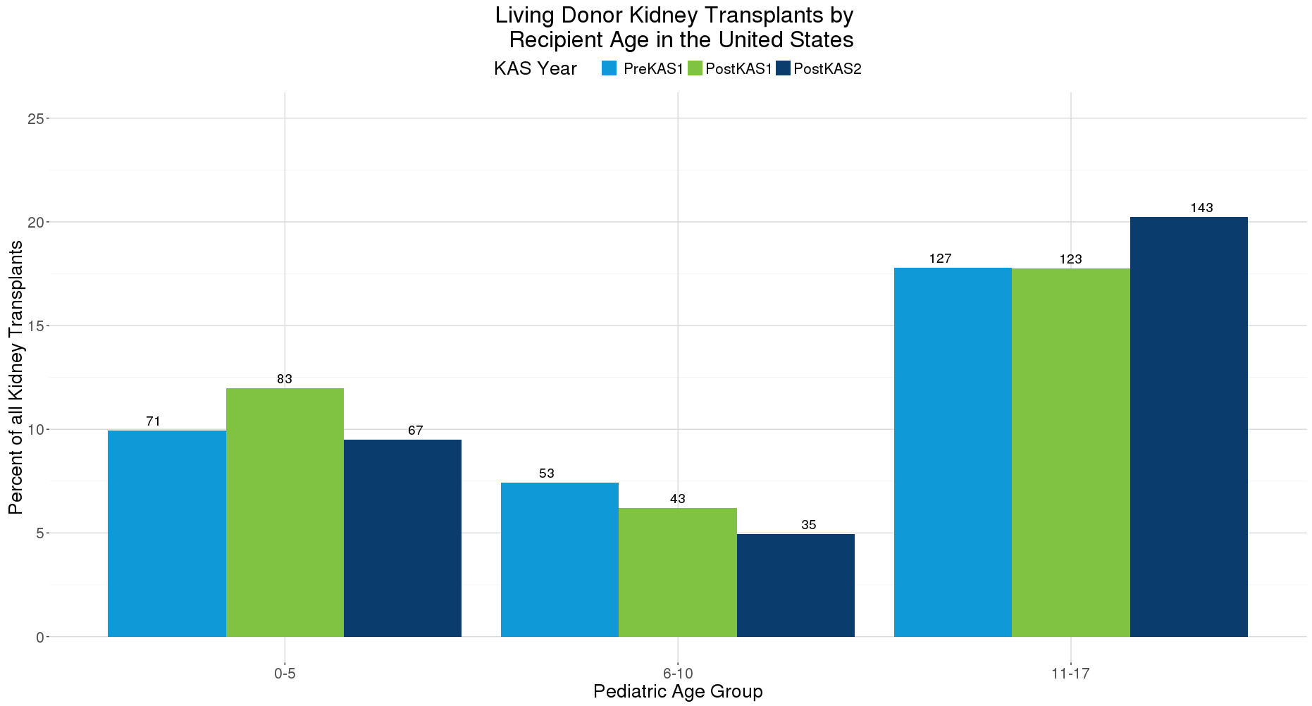
Percent of Pediatric Kidney Alone Transplants that are Living Donor in the US
Compared to pre-KAS, the number and percent of LD transplants to pediatrics
was the same for ages 0-5, lower for 6-10, but higher for 11-17.
Notes:
Compared to pre-KAS, the number and percent of living donor transplants to pediatrics was the same for ages 0-5, lower for 6-10, and higher for 11-17.

Slide 22
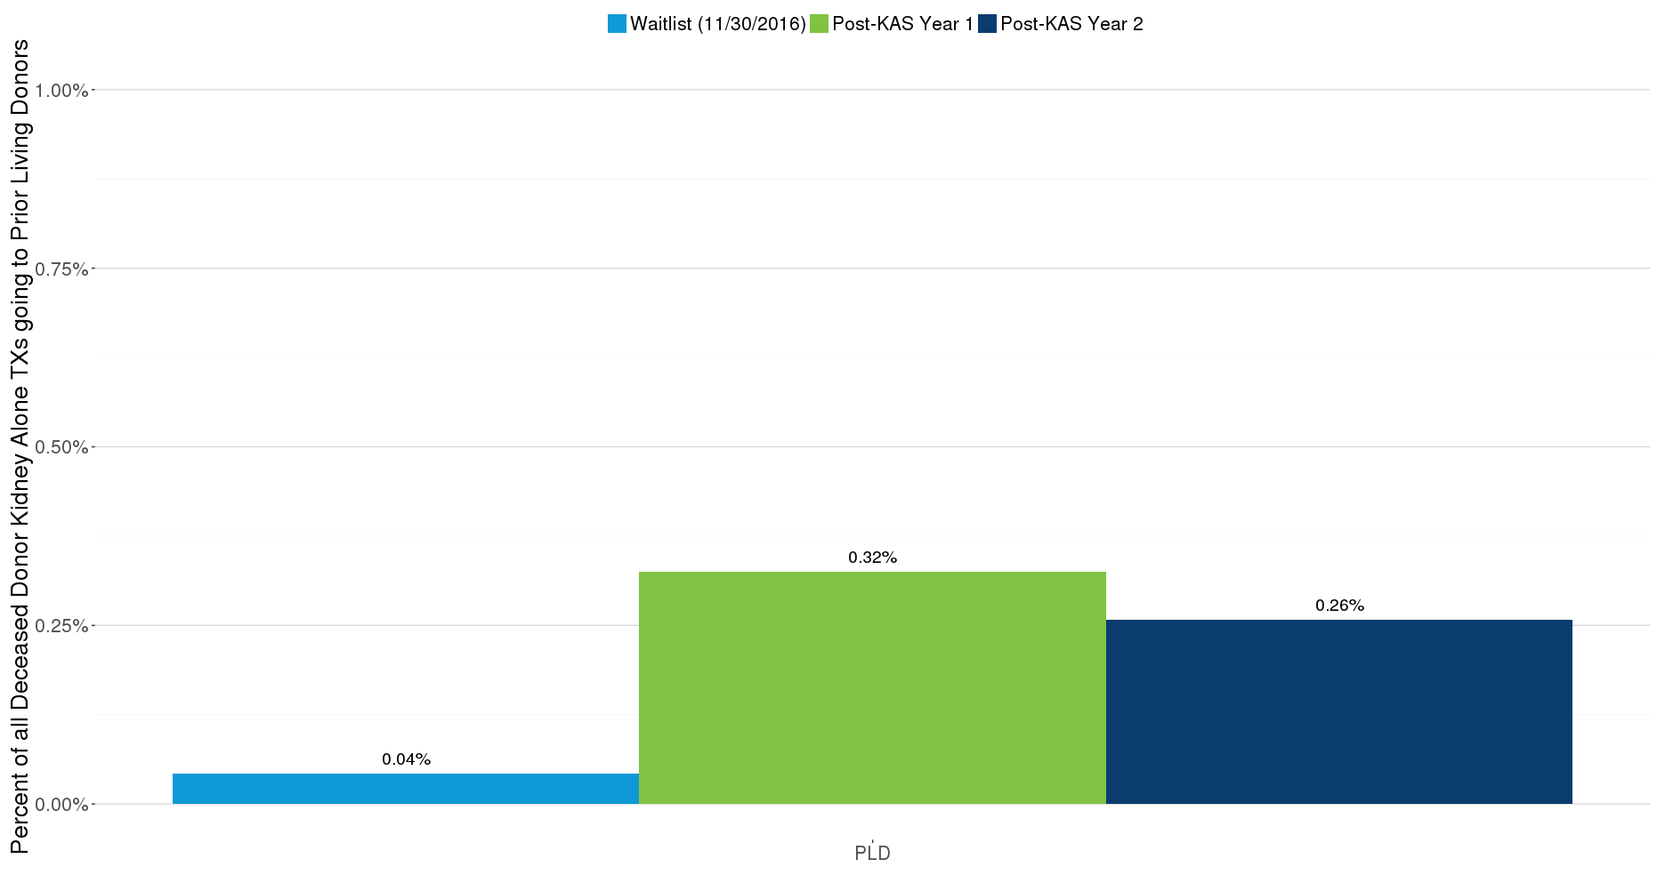
Deceased Donor Kidney Alone Transplants by Recipient Prior Living Donor Status
Transplants were lower post-KAS for prior living donors compared to pre-KAS (0.4%),
but numbers remain very small and higher than WL representation.
Notes:
Transplants were lower post-KAS for prior living donors compared to pre-KAS, but the numbers remain very small and higher than waitlist representation.

