Slide 1
Clarifications on Reporting Maintenance Dialysis
OPTN/UNOS Living Donor Committee

Slide 2
What problem will the proposal solve?
Current policy term “begins dialysis” is not specific; unclear if reporting includes chronic and acute dialysis
Clarify and standardize terminology to improve reporting accuracy
Notes:
Members have raised questions regarding the meaning of the phrase "begins dialysis" in Policy 18.6. Specifically, it is not currently clear whether the phrase “begins dialysis” requires reporting chronic dialysis representing end-stage renal failure and/or acute dialysis.
In addition, there are several other areas within policy language, TIEDI, and the Patient Safety Portal which refer to the decrease or loss of renal function in a living donor using inconsistent terminology.
Clarifying when transplant hospitals should report chronic versus acute dialysis in the sections of policy and harmonizing terminology on forms will help centers accurately report living donor events. In addition, greater clarity in reporting will improve safety reviews and the understanding of clinical events after living donation.

Slide 3
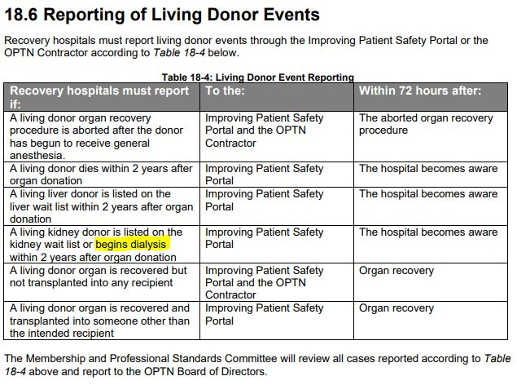
Current Policy Language: “Begins Dialysis”
Notes:
This slide shows the current policy language in Policy 18.6, Table 18-4: Living Donor Event Reporting. This includes updating Table 18-4 to read as “begins regularly administered dialysis as an ESRD patient.”
This review also pinpointed areas for further improvement on consistency with living donor kidney policy language. This includes changing “maintenance dialysis” in Policy 18.5.A to mirror the changes in Policy 18.6.
Policy 18.5 and Policy 18.6 lay the ground work for the TIEDI Living Donor Follow Up form and the Patient Safety Portal’s Living Donor Event Form respectively (GO TO NEXT SLIDE).

Slide 4
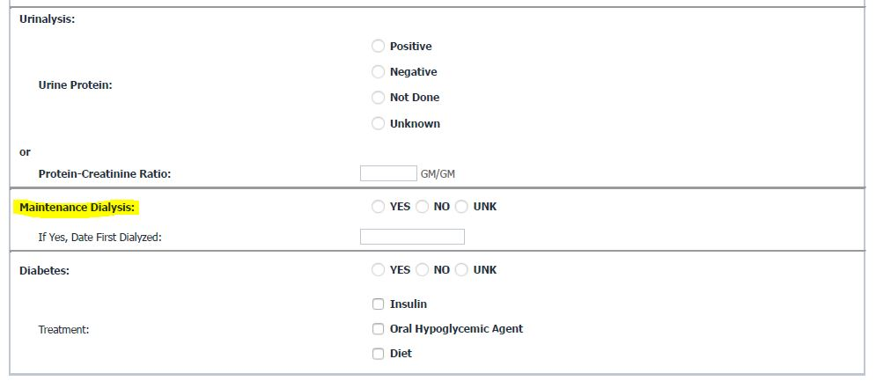
Patient Safety Portal and TIEDI
Notes:
Simple label changes include what is shown on this slide. As previously mentioned, Policy 18.5.A currently used the term “maintenance dialysis.” This term is synonymous with “regularly administered dialysis as an ESRD patient,” so it will be changed to reflect updated policy language (GO TO NEXT SLIDE TO SHOW KIDNEY COMPLICATIONS, OTHER – SPECIFY IN TIEDI LDF).

Slide 5
Patient Safety Portal and TIEDI
Notes:
The Living Donor Committee particularly honed in on “Kidney Complications: Other – Specify” in the TIEDI Living Donor Follow Up form. Currently, data are hard to collect due to the open-nature of this text field. The Living Donor Committee sought to balance the need for more granularity in the data with not increasing reporting burden in any way. As such, the “Specify” text box field will include examples of what types of other complications should be added by data coordinators (i.e., AKI, CKD, etc.).

Slide 6
What are the proposed solutions?
Policy 18.6: add “regularly administered dialysis as an End Stage Renal Disease (ESRD) patient” to the term “dialysis”
Policy 18.5.A: change “maintenance dialysis” to “regularly administered dialysis as an ESRD patient” to match terminology throughout policy language
Policy 1.2: remove “N – Native organ failure” and its definition from Policy 1.2
Requires IT programming in Patient Safety Portal and TIEDI™
Notes:
The proposed solution includes minor policy language changes in three places: Policy 18.6, Table 18-4; Policy 18.5.A, and Policy 1.2.
Removing Policy 1.2 is done because the term is outdated.
The changes here involve synthesizing terminology and removing any outdated language. Changes to the TIEDI and Patient Safety Portal data forms will be label changes meant only to clarify and remain consistent with policy language.

Slide 7
How will members implement this proposal?
No additional data entry requirements; label changes to data forms are meant to increase clarity and will not add additional reporting burdens

Slide 8
Questions?

