Slide 1
Pancreas Transplantation Committee Update: Pancreas Underutilization Project
Jonathan Fridell, MD, Chair

Slide 2
Strategic Plan
Goal: Increase the number of transplants
Notes:
The strategic plan’s goal this project supports is increasing the number of transplants. The project aims to increase the number of transplants by investigating why there has been a reduction in the number of pancreas transplants, what can be done to reverse this decrease, and communicate the findings to the pancreas community.

Slide 3
Objective
Investigate reasons for reduction in PA transplants
Updates to facilitated PA allocation policy and process
Notes:
The Committee continues to work on it’s Pancreas Underutilization project. This project includes policy language changes to the Facilitated Pancreas Allocation policy and investigating why there is a reduction in the number of pancreas transplants. As part of the investigation regarding the reduction in the number of pancreas transplants, the Committee is also looking at the reason for high pancreas discards. Currently, the Committee is in the data analysis phase.
As a reminder, Facilitated Pancreas Allocation is an additional pancreas placement method that takes effect after a certain period of time where the pancreas has not been placed. Currently, transplant programs may elect to be a part of this additional pancreas placement method without requiring a track record of performance (ex. Importing or using ECDs) and the Organ Center works with the transplant programs that are a part of the Facilitated Pancreas Allocation in order to make the placement happen.
The Committee is currently drafting updates to the facilitated pancreas allocation policy, which includes adding the following information to the policy:
Create qualifying criteria for transplant hospitals to participate in facilitated pancreas allocation
Create monitoring mechanism or review system to assess whether participating transplant hospitals are correctly utilizing facilitated pancreas allocation
Update time requirements associated with facilitated pancreas allocation
Remind pancreas transplant hospitals of the facilitated pancreas allocation option
As mentioned, the Committee is considering creating a routine monitoring process to assess whether participating transplant programs are correctly utilizing the Facilitated Pancreas Allocation process. The details of this monitoring process are not available yet, however, the monitoring process may consist of a report that the Committee annually reviews to ensure participating transplant programs are not abusing the Facilitated Pancreas Allocation process. Would you support creating qualifying criteria and a routine monitoring process for transplant programs participating in the Facilitated Pancreas Allocation process?
Look for a public comment with these policy changes in early 2015 or summer 2015.

Slide 4
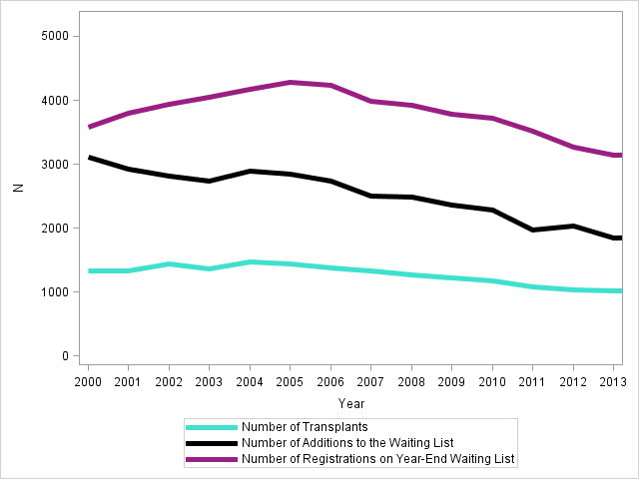
All Pancreas Transplant Types, longitudinal trends from 2000 through 2013
Notes:
All Pancreas Transplant Types, longitudinal trends from 2000 through 2013.
The figure on the slide shows that, independent of blood type, all pancreas transplants seem to have plateaued between 2003 and 2005, and have steadily been decreasing ever since. The size of the national waiting list has not grown during this decline, which suggests the overall activity in pancreas transplantation is on a decline. Further, the number of registrations added to the waiting list is less and less each year.

Slide 5
Notable PA Discard Reasons: Deceased Donors recovered in the US from 1/1/02 - 12/31/03 and 7/1/12 - 6/30/14
Reasons for PA Discard | Era 1 1/1/02 – 12/31/03 | Era 2 7/1/12 – 6/30/14
Not reported | 10.8% (N = 86) | 0.2% (N = 1)
Poor organ function | 9.8% (78) | 7.5% (50)
Anatomical Abnormalities | 17.0% (135) | 21.7% (144)
No recipient located – list exhausted | 9.3% (74) | 14.2% (94)
Other, specify | 20.5% (163) | 34.2% (227)
Notes:
For all deceased donors recovered in 2002 or 2003 and then from 7/1/2012 through 6/30/2014, the Committee wanted to see for those who had the pancreas discarded after it was recovered for transplant, the reason that the organ was discarded, as reported on the deceased donor registration (DDR) form to the OPTN.
The table on the slide shows the notable PA discard reasons for the two eras: 1/1/02 – 12/31/03 (all of 2002 and 2003), and 7/1/12 through 6/30/14. Please note that this table does not include all the reasons for pancreas discards.
The table shows that in first era, 17% of the reason for pancreas discards were reported due to Anatomical abnormalities, and 11% of discarded pancreata did not report a reason for the discarded pancreas. Also, 9% of discarded pancreata show the reported reason for the discard as “No recipient located – list exhausted” and 20% reported the reason for the discard as “Other, specify”. Those reporting “Other, specify” were largely due to organ quality, placement efforts, or islet usage. (Note that the granularity at which “Other, specify” text is reported does not make it conducive to reporting in this setting, so the broad topics covered for these instances will be noted in the text only, where “Other, specify” is chosen for a large percentage of the population.)
For the second era, 21% of the reason for pancreas discards were reported due to Anatomical abnormalities, 14% of discarded pancreata reported the reason for the discard to be “No recipient located – list exhausted” and 34% were “Other, specify” – which did not yield much more information than Era 1. Poor organ function was also a frequently used discard code for both eras.

Slide 6
Notable PA Not Recovered Reasons: Deceased Donors recovered in the US from 1/1/02 - 12/31/03 and 7/1/12 - 6/30/14
Reasons for PA Discard | Era 1 1/1/02 – 12/31/03 | Era 2 7/1/12 – 6/30/14
Other Specify | 12.7% (N = 165) | 8.2% (N = 89)
Poor Organ Function | 18.4% (239) | 7.8% (85)
No Recipient Located | 6.6% (86) | 9.6% (104)
Organ Refused By All National Program | 2.0% (26) | 16.8% (183)
Ruled Out After Evaluation in OR | 7.1% (92) | 24.8% (270)
Notes:
The table on this slide shows deceased donors recovered in the US from 1/1/02 and 12/31/03 or 7/1/12 through 6/30/14 that had at least 1 organ recovered for transplant, were age 35 or younger, BMI 30 or less, creatinine 1.5 or less, not PHS high risk for blood-borne disease, and not in the worst 25% of PDRI. For all such donors who did not have their pancreas recovered for transplant, the notable distribution for reasons the pancreas was not recovered is shown by era.
The Committee was interested in looking at reasons why the organ was not recovered for donors that seem to be reasonable pancreas donors. This field is reported on the DDR for donors where the organ was not transplanted.
The committee qualifies a reasonable deceased pancreas donor with the following criteria:
Age < 35
BMI < 30
Creatinine < 1.5
Not PHS high risk for blood-borne disease
In lower 75% of PDRI (region specific)
For Era 1, the two highest reported reasons for the organ not being recovered were “poor organ function” (18%) and “Other, specify” (13%). When scanning the “Other, Specify Text”; “Age” and “Unknown” were the most frequently reported text. (Note that the granularity at which the “Other, specify” text is reported does not make it conducive to reporting, so the broad topics covered for these instances will be noted in the text only, where “Other, specify” is chosen for a large percentage of the population.)
For Era 2, the most predominantly reported reasons for pancreas organs not being recovered were “Organ refused by all national program” (17%) and “Ruled out after evaluation in OR” (25%). Notably, “Other, Specify” was only chosen for 8% of these donors, but when it was, it was largely due to DCD donors.

Slide 7
Preliminary Findings
PA transplant activity peaked in early 2000s and has been on the decline since approximately 2005
Decline has not been driven solely by the decrease in PA transplants or rise in PA discards
Overall waiting list size and annual additions to the waiting list have both steadily decreased
Notes:
The Committee has been investigating the reasons behind reduction in the number of pancreas transplants and increasing trends in pancreas discards. Based on the research reviewed thus far and the Committee’s discussions surrounding the potential reasons for pancreas underutilization, the Committee believes that the pancreas transplant community will benefit from a guidance document on the best practices for how to effectively utilize pancreas and kidney-pancreas waivers. As such, the Committee is currently gathering information to include in the guidance document.
Preliminary findings of the data requests show the following:
Pancreas transplant activity peaked in early 2000s and has been on the decline since approximately 2005
The decline has not been driven by solely the decrease in pancreas transplants or rise in pancreas discards
Overall waiting list size and annual additions to the waiting list have both steadily decreased, which shows doctors aren’t considering patients for pancreas transplants as much as they used do
The Committee will continue to review the results of outstanding data requests and will publish its investigation findings in a manuscript.

Slide 8
Questions?
Thank you!
Jonathan Fridell, MD, Committee Chair
jfridell@iupui.edu
Kristina Tyler JD, Committee Liaison
Kristina.Tyler@unos.org

Slide 9
Back-up Slides

Slide 10
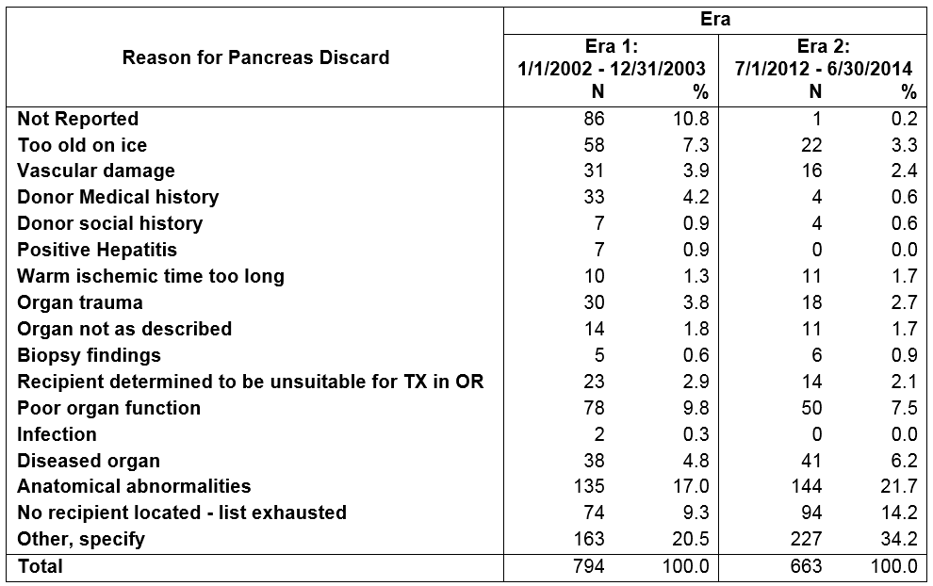
Deceased donors recovered in the US from 1/1/2002 and 12/31/2003 or 7/1/2012 through 6/30/2014 that had at least 1 organ recovered for transplant who had their pancreas recovered for transplant and not transplanted (discarded). The distribution for discard reason is shown by era (1/1/2002 and 12/31/2003 or 7/1/2012 through 6/30/2014)
Notes:
For all deceased donors recovered in 2002 or 2003 and then from 7/1/2012 through 6/30/2014, the subcommittee wanted to see for those who had the pancreas discarded after it was recovered for transplant, the reason that the organ was discarded, as reported on the deceased donor registration (DDR) form to the OPTN. The table includes all such donors and reasons separated by the era they were recovered. The most recent two years of available data, 7/1/2012 through 6/30/2014, will be referred to as Era 2, and the time period including all of 2002 and 2003 will be referred to as Era 1.
The granularity at which Other, specify text is reported does not make it conducive to reporting in this setting, so the broad topics covered for these instances will be noted in the text only, where Other, specify is chosen for a large percentage of the population.
The table shows that in the Era 1, 17% of the reason for pancreas discards were reported due to Anatomical abnormalities, and 11% of discarded pancreata did not report a reason for the discarded pancreas. Also, 9% of discarded pancreata show the reported reason for the discard as “No recipient located – list exhausted” and 20% reported the reason for the discard as “Other, specify”. Those reporting other specify were largely due to organ quality, placement efforts, or islet usage.
For Era 2, 21% of the reason for pancreas discards were reported due to Anatomical abnormalities, 14% of discarded pancreata reported the reason for the discard to be “No recipient located – list exhausted” and 34% were “Other, specify” – which did not yield much more information than Era 1. Poor organ function was also a frequently used discard code for both eras.

Slide 11
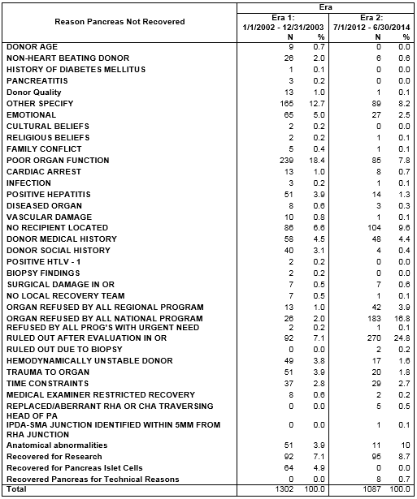
Notes:
Deceased donors recovered in the US from 1/1/2002 and 12/31/2003 or 7/1/2012 through 6/30/2014 that had at least 1 organ recovered for transplant, were age 35 or younger, BMI 30 or less, creatinine 1.5 or less, not PHS high risk for blood-borne disease, and not in the worst 25% of PDRI. For all such donors who did not have their pancreas recovered for transplant, the distribution for reasons the pancreas was not recovered is shown by era.
For the second part of this report, the subcommittee was interested in reasons why the organ was not recovered for donors that seem to be reasonable pancreas donors. This field is reported on the DDR for donors where the organ was not transplanted.
The most recent two years of available data, 7/1/2012 through 6/30/2014, will be referred to as Era 2, and the time period including all of 2002 and 2003 will be referred to as Era 1. The granularity at which Other, specify text is reported does not make it conducive to reporting in this setting, so the broad topics covered for these instances will be noted in the text only, where Other, specify is chosen for a large percentage of the population.
The committee qualifies a reasonable deceased pancreas donor with the following criteria:
Age < 35
BMI < 30
Creatinine < 1.5
Not PHS high risk for blood-borne disease
In lower 75% of PDRI (region specific)
This table shows the distribution of reasons the pancreas was not recovered for all reasonable pancreas donors in 2002 and 2003 (Era 1) and in the most recent two years, 7/1/2012 through 6/30/2014 (Era 2).
For Era 1, the two highest reported reasons for the organ not being recovered were “poor organ function” (18%) and “Other, specify” (13%). When scanning the “Other, Specify Text”; “Age” and “Unknown” were the most frequently reported text.
For Era 2, the most predominantly reported reasons for pancreas organs not being recovered were “Organ refused by all national program” (17%) and “Ruled out after evaluation in OR” (25%). Notably, “Other, Specify” was only chosen for 8% of these donors, but when it was, it was largely due to DCD donors.

