Slide 1
Proposal to Delay the HCC Exception Score Assignment (Resolution 9) Liver and Intestine Committee David Mulligan, Chair November 12 and 13, 2014

Slide 2
The Final Rule: 42 CFR Part 121 October 20, 1999
§121.8 of the Final Rule states that allocation policy should be based on “objective and measurable medical criteria, for patients or categories of patients who are medically suitable candidates for transplantation to receive transplants”
Waiting time should be de-emphasized
Patients should be rank ordered according to severity of disease and predicted mortality on the liver list
Notes:
The Final Rule mandates that donor livers be prioritized to go to those most likely to die. As noted, the current HCC policy is gives high priority to stable HCC candidates who have a low mortality risk. And while HCC patients are given priority so that they don't become untransplantable, we need to balance that against those who are at immediate risk for death

Slide 3
The Problem
Candidates with HCC exceptions receive high priority on the waiting list
Scores may increase automatically every three months
Most patients treated (90%), many with stable tumors
HCC: Significantly lower dropout rates than non-HCC
Notes:
Candidates with a MELD/PELD score exception for HCC receive high priority on the liver waiting list, especially as their exception scores may increase automatically every three months.
These candidates are likely to have a much lower risk of disease progression or dropout (i.e., removal from the waiting list for death or being too sick). The next two slides provide evidence of this.
The equalization of dropout and transplant rates between HCC and non-HCC candidates occurs naturally in areas with longer waiting times.
The problem the Committee is trying to solve is: “How do we even out these rates in other areas of the country?”

Slide 4
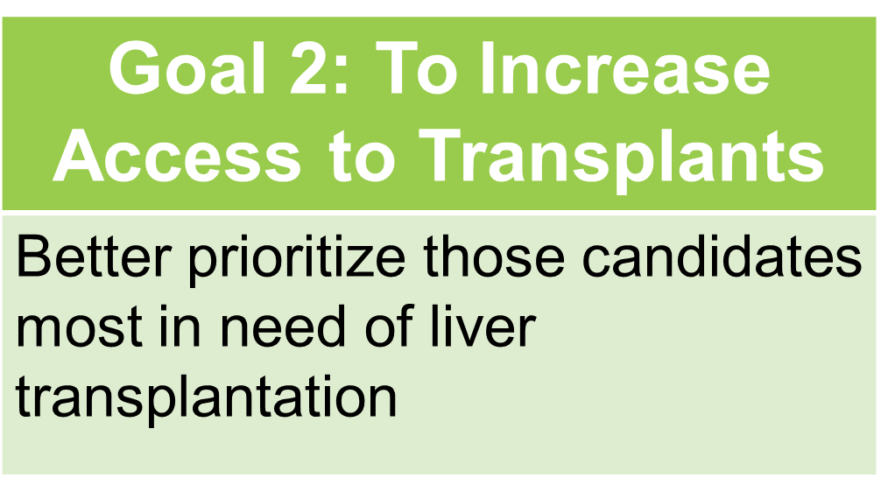
Strategic Plan
Notes:
The proposed policy would promote goal 2 of the strategic plan, to increase access to transplant by better prioritizng those candidates most in need of liver transplant.

Slide 5
Goal of the Proposal
To promote equalization of dropout and transplant rates between HCC and non-HCC liver transplant candidates
Notes:
Delaying the HCC Exception Score Assignment will address the disparities in transplant/drop-out rates between patients with HCC exceptions and those without. This occurs naturally in areas of the country with longer waittimes.

Slide 6
How the Proposal will Achieve its Goals
Currently, as long as the candidate meets criteria, the initial score assignment is 22, followed by increases every 3 months
 | Current Schedule | Proposed Schedule
Initial Score | 22 | Calculated MELD Score
First Extension (3 months) | 25 | Calculated MELD Score
Second Extension (6 months) | 28 | 28
Remainder of schedule the same (29, 31, 33, etc.)
Notes:
This table shows the current schedule for HCC scores, stating at 22, and increasing to 25 at 3 months, and 28 at six months.
Under this proposal, candidates would be listed with the calculated MELD score for that first 6-month period, as shown in the column on the right.
Submission of the HCC exception form will otherwise remain the same way we do it today, with the tumor sizes, imaging findings, etc., being submitted on the initial application. The three-month extension form (and all extension forms) would stay the same as well. The only difference is the score assignment.
As always, cases may be referred to the RRB if the center feels the candidate needs additional priority.

Slide 7
Delay HCC Supporting Evidence
LSAM modeling: delay led to similar transplant rates between HCC and non-HCC
At least in regions with lower waiting times
Study by Halazun, et al: Recipients with HCC exceptions have worse outcomes in regions with shorter waiting times
“Biologic test” not met due to rapid transplantation
Notes:
LSAM modeling indicates that this delay will even out the transplant rates, providing better access to non-HCC candidates.
A secondary benefit of the delay is that it will allow more time for the biology of these tumors to be assessed. A study presented at the 2013 ATC suggested that areas with lower waiting times have poorer post-transplant outcomes for those with HCC, because those with poor tumor biology are transplanted quickly. In areas with longer waiting times, the poor biology can be observed and the candidates removed from the list.

Slide 8
Transplant Rates by HCC Status LSAM Modeling Results
Notes:
This shows the LSAM modeling results, showing the expected impact of the delay on transplant rates.

Slide 9
Delay HCC Supporting Evidence
Overall Dropout Rates for HCC and Non-HCC Candidates: Listed 4/14/04-12/31/07
Notes:
Washburn et al showed that dropout rates are significantly lower for those with HCC exception. This was also affirmed by a paper by Massie, et al, stating that “Both HCC and other exceptions “were associated with decreased risk of waitlist mortality compared to non-exception patients with equivalent listing priority (p<0.001)”.

Slide 10
% Dropout within 12 Months: HCC and Non-HCC Candidates by Region Candidates Added 7/1/08 – 6/30/11
Notes:
This, from Washburn et al also, shows the variation in dropout rates across regions.

Slide 11
Public Comment
Public Comment: 31 responses were received. Of these, 14 (41.16%) supported the proposal, 9 (29.03%) opposed the proposal, and 8 (25.81%) had no opinion. Of the 23 who responded with an opinion, 14 (60.87%) supported the proposal and 9 (39.13%) opposed the proposal.
Regional Responses: Opposed by 2, 3, 11
Notes:
Those who opposed the proposal seemed to perceive a lack of data in support, some expressed concern that this would limit access to patients when transplant is appropriate or limit access for minorities and income restricted candidates who may not present to the transplant center for some time after initial diagnosis.
The Committee agreed that rather than a lack of data there had been a lack of proper communication which likely contributed to the lack of support. Modeling data included in the proposal showed that a 6 month delay would not disadvantage this population but would reduce the disparity in the transplant and drop-out rates for those with and without HCC exceptions. In areas of the country with shorter waiting times to transplant, the delay will also allow a window of time for centers to observe candidates with rapidly growing tumors who may have very poor outcomes with a transplant. HCC candidates demonstrating a need for higher priority may be referred to the Regional Review Board (RRB) for consideration.
Additionally, concerns were voiced that bad tumor biology was unlikely to manifest in any obligatory waiting period. The Committee felt this to be an inaccurate statement citing that in regions where wait times are substantially longer, bad tumor biology does in fact have time to manifest. As mentioned above, the option for RRB appeal remains intact for those candidates who demonstrate a need for higher priority.
Some commented that this proposal would not alleviate the current geographic disparity. This proposal is intended to reduce the disparity in waiting list drop-out rates (removals for death/”too sick”/other removals due to HCC) between HCC and non-HCC candidates, not to reduce the national geographic disparity. The Committee is currently pursuing other projects to address the national geographic disparity. Likewise, this policy proposal was not intended to address OPO performance.

Slide 12
Committee Response
HCC Subcommittee Recommendation: Forward to the Board without substantial post public comment changes.
Committee voted in support:
14 in favor: 0 opposed: 1 abstentions
Notes:
Ultimately the Committee voted in favor of presenting this proposal to the Board without post public comment changes, 14:0:1.

Slide 13
Overall Project Impact
Product
Policy
Target Population Impact:
Liver Transplant Candidates
Total IT Implementation Hours
Total Overall Implementation Hours
600/10,680
805/17,885

Slide 14
RESOLUTION 9, Page 18
RESOLVED, that Policies 9.3.G are modified as set forth below, effective pending programming implementation and notice to OPTN membership.
Candidates with Hepatocellular Carcinoma (HCC)
Upon submission of the required information to the OPTN Contractor, candidates with Hepatocellular Carcinoma (HCC) that have stage T2 lesions and meet the criteria according to Policies 9.3.G.i through vi below will be listed at their calculated MELD or PELD score
9.3.G.vi Extensions of HCC Exceptions
In order for a candidate to maintain an HCC approved exception, the transplant program must submit an updated MELD/PELD exception application every three months. The candidate will receive the additional priority until transplanted or is found unsuitable for transplantation based on the HCC progression. Upon submission of the first extension, the candidate will be listed at the calculated MELD/PELD score. Upon submission of the second extension, the candidate will be assigned a MELD/PELD score equivalent to a 35 percent risk of 3-month mortality (MELD 28/PELD 41). For each subsequent extension, The candidate will receive additional MELD or PELD points equivalent to a 10 percentage point increase in the candidate’s mortality risk every three months.

Slide 15
Thank you for your consideration. Questions?
David Mulligan, MD
Committee Chair
David.Mulligan@yale.edu
Ashley Archer-Hayes, MAS
Committee Liaison
Ashley.Archer-Hayes@unos.org

