Slide 1
Guidance to Organ Procurement Organizations for Allocation of Heart-Lung Blocks (Resolution 12)
OPTN/UNOS Thoracic Organ Transplantation Committee
Dr. Joe Rogers

Slide 2
Problem
Policy 6.5.E: Allocation of Heart-Lungs does not provide OPOs with ample direction to allocate heart-lung blocks consistently

Slide 3
OPTN Strategic Plan
#2: Increase Access to Transplant
Objective: Address multi-organ allocation issues
Strategy: Develop guiding principles for multi-organ allocation
Initiative: Develop clear policy to guide OPO practice

Slide 4
Goals
Clarify heart-lung allocation policy
Promote a consistent practice amongst OPOs throughout the country when allocating heart-lung blocks

Slide 5
How the Proposal Will Achieve Its Goal
Thoracic Committee agreed upon interpretation of Policy 6.5.E
Thoracic Committee presented interpretation to OPO Committee
OPO Committee provided help operationalizing the interpretation

Slide 6
Overall Project Impact
Product
Guidance Document
Target Population Impact:
OPOs and heart-lung transplant candidates
Total IT Implementation Hours
0/10,680
30/17,885
Total Overall Implementation Hours
Notes:
Option 7: Different smart art

Slide 7
Interpretation of Policy 6.5.E
Current policy: “When a heart-lung candidate is allocated a heart, the lung from the same deceased donor must be allocated to the heart-lung candidate.
Clarification: If the OPO generates the heart or heart-lung match run, the heart will be offered in order of the match. If a heart candidate is eligible to receive the heart offer, but also needs a lung, then that candidate shall be allocated the lung from the same donor.
Current policy: “When the heart-lung candidate is allocated a lung, the heart from the same deceased donor may only be allocated to the heart-lung candidate if no suitable Status 1A isolated heart candidates are eligible to receive the heart.”
Clarification: If the OPO generates the lung match run, and the next eligible candidate for the lung offer also needs the heart, the candidate will receive the heart-lung block offer unless there is a Status 1A isolated heart candidate in the same geographic zone as the heart-lung candidate.

Slide 8
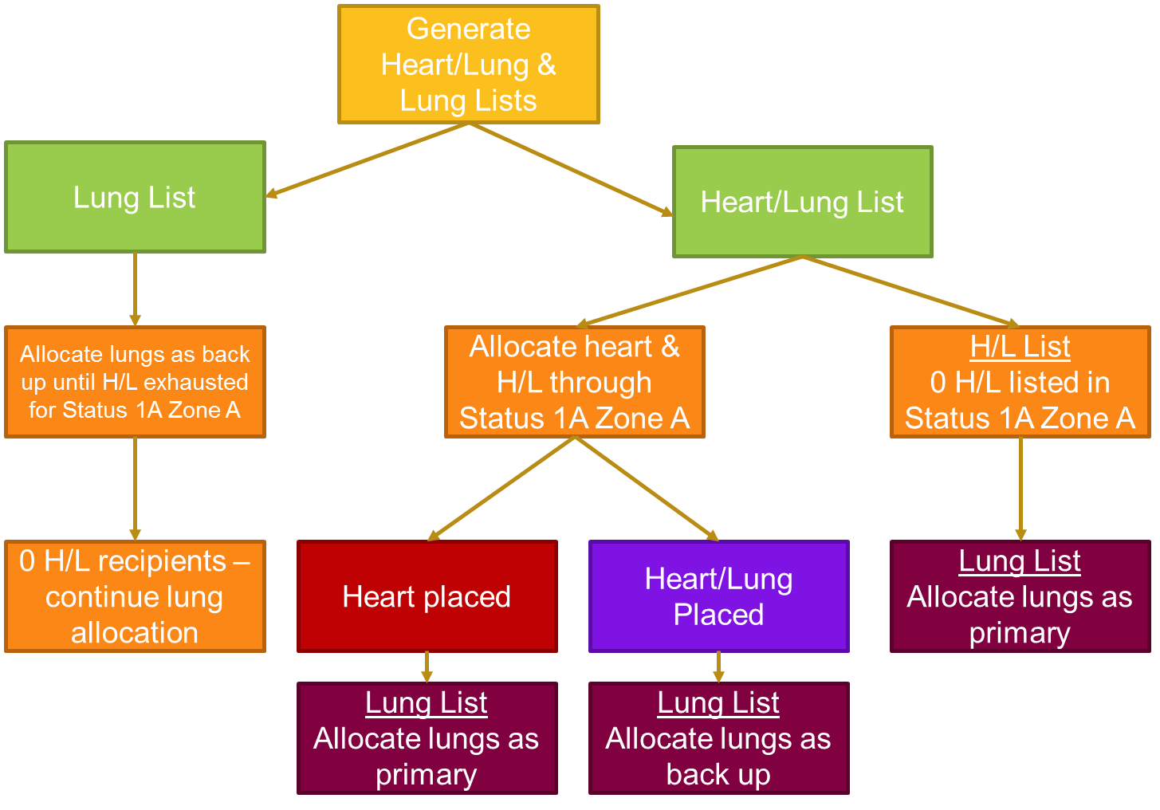
Guidance

Slide 9
Resolution 12 (page 21)
RESOLVED, that the guidance document entitled “Guidance to Organ Procurement Organizations for Allocation of Heart-Lung Blocks,” as set forth in Exhibit A, is hereby approved, effective November 13, 2014.

Slide 10
Extras

Slide 11
Guidance
Generate both a combined heart-lung match run and a lung match run simultaneously
Using the combined heart-lung match run:
Within the donation service area (DSA), allocate the heart to all status 1A heart candidates
If the status 1A heart candidate only needs a heart, the heart should be offered to that candidate
The lung(s) will be allocated from the lung match run
If the status 1A heart candidate is also registered for a lung, the heart-lung block should be offered to that candidate
Using the lung-alone match run:
If there are no status 1A isolated heart candidates or heart-lung candidates, or if all status 1A isolated heart candidates and status 1A heart-lung candidates decline within the same DSA, then the lungs may be offered from the lung match run to isolated lung candidates and lung-heart candidates within the DSA
If the lungs are accepted within the DSA for an isolated lung candidate, the heart should then be allocated using the heart-lung match run
Repeat steps 2 and 3 for each successive geographic zone until the organs are allocated

