Slide 1
Operations and Safety Committee Update
Theresa Daly MS, FNP

Slide 2
Current Projects:
Infectious Disease Verification (IDV)
Sharing Patient Safety Data and Lessons Learned
Electronic Tracking and Transport (ETT)-now known as TransNet-A service of the OPTN
Notes:
I’m going to give you an update on three projects being led by the Operations and Safety Committee.
Infectious Disease Verification (IDV)
Sharing Patient Safety Data and Lessons Learned
Electronic Tracking and Transport (ETT)-now known as TransNet-A service of the OPTN

Slide 3
IDV: Problem Statement
Living and deceased donors with infectious diseases have donated organs to recipients who did not know/give consent to receive infected organs
Positive results for the infectious diseases were available prior to transplant but were missed or overlooked
Some cases have led to disease transmission
Notes:
Living and deceased donors with infectious diseases have donated organs to recipients who did not know/give consent to receive infected organs. Positive results for the infectious diseases were available prior to transplant but were missed or overlooked. Some cases have led to disease transmission.
There have been 5 proven/probable viral DTAC cases 2009-present related to this issue
60% Deceased donor/ 40% Living donor involving HCV (3) and CMV (2)
Twelve recipients received infected organs and five became infected.
There have been an additional 2 living donor and 1 deceased donor cases with similar process issues reported but no proven/probable transmission.
This issue was received to Ops and Safety from an MPSC referral and as a HOPE Act work group recommendation.

Slide 4
Possible IDV Step
Questions already in UNet
Test specific with additions from HOPE and PHS
Agreement to require double user verification of “Yes” answers-which infectious diseases?
Step 2:
Candidate Blood Type entered into UNet x 2 (TXC)
Step 2: Candidate Willing to Accept Infected Organs? (TXC)
Double user verification here
Notes:
We are working with representatives from OPO, TAC, and TCC as well as members of the original HOPE Act safety subgroup to develop a proposal for winter 2015 public comment.
Current policy requires infectious disease (or serology) verification for not on match run cases as well as use of extra vessels in secondary recipients and living donors but not all organs.
Now that you are very familiar with ABO steps, it will hopefully make sense that we are looking where we might overlay infectious disease verification. We are going step by step.
I’m showing you an example right here. We are looking at possible second user verification for candidates willing to accept HIV positive organs which would only be allowed in HOPE Act transplant hospitals as well as possibly including HBV and HCV.
Step 2 as you can see is slightly different than ABO in that we do not collect candidate HIV, HBV, and HCV results currently. What is parallel though is that candidates must indicate if they are willing to accept an infected organ (HIV will be added as part of HOPE Act).
We would welcome any input from the Board on this process.

Slide 5
Sharing Patient Safety Data and Lessons Learned
Educating members on lessons learned from adverse events and near misses
Protecting peer confidentiality
Receiving benefits from reporting
Notes:
This is key to building our culture of safety. Our goal is to have members benefit from past experiences and lessons learned while protecting and maintaining peer confidentiality.
In June 2013, the Executive Committee approved a project to work on this issue that is part of the OPTN Strategic Plan.

Slide 6
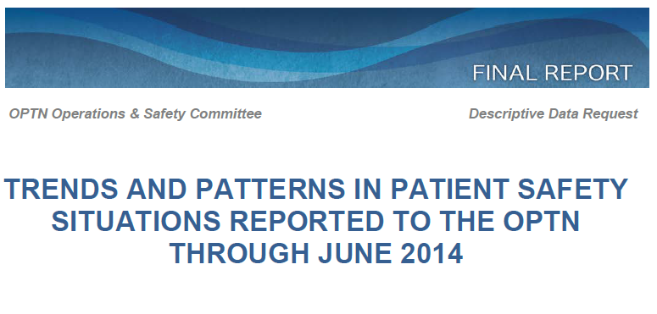
How?
Patient Safety Alerts
Review of aggregated, de-identified safety situation report events
MPSC topic referrals after each meeting
Notes:
We have several tools available. These include:
Review of aggregated, de-identified safety situation report events-we do this every six months at our in person meeting
MPSC topic referrals after each meeting
Patient Safety Alerts

Slide 7
How?
Patient Safety News articles
Regional Meeting: Safety data and messages
Instructional Events: Two times per year
Presentations
Manuscript/abstracts
Notes:
Patient Safety News articles-we also include a link to our latest safety data report
Regional Meeting: Safety data and messages
Instructional Events: Two times per year-Instructional Innovations is working to produce these
Presentations to professional societies and committees (such as AOPO)
Manuscript/abstracts

Slide 8
Where to focus our efforts
Events related to Organ Not Tx’d (2012-Jun 2014) | Event Frequency and Organ Not Tx’d* | High Frequency | Increased Frequency | Selected as Priority
communication issue - delayed communication | 9 | Yes | Yes | Yes
communication issue - inaccurate/insufficient donor or organ/ extra vessels information | 8 | Yes |  | Yes
recovery procedure/process issue - injury to organ or extra vessels | 7 | Yes
living donor issue - organ recovered but not transplanted | 5 |  |  | Yes
switched laterality - kidneys (packaging/shipping issue and/or labeling issue) | 5 | Yes | Yes | Yes
recovery procedure/process issue - poor donor management | 5
Notes:
We are also looking at events associated with an organ not transplanted (not recovered or not used) as well as events that occur most often or show a statistically significant increase.
Our patient safety advisory group will be taking a closer look at these event subcategories which the Committee identified as top priority based on the data available. Some event subcategories such as switched laterality already have active projects to address the issue.

Slide 9
TransNet^{sm} – Beta Test - OPOs
Eight OPOs – September 18, 2014 – January 15, 2015
Participating OPOs | Location
CADN | San Francisco, California
GALL | Atlanta, GA
MAOB (new) | Boston, MA
MDPC | Baltimore, MD
MOMA (new) | St. Louis, MO
MNOP | Minneapolis, MN
VATB | Richmond, VA
WALC (new) | Seattle, WA
Notes:
Version 5.0 was created based on feedback from last beta test
Train the trainer in Richmond Sept 10-11
Visits to new OPOs to observe training and cases – evaluate train the trainer methodology
As of October 28 – used the system on 84 donors/266 organs
Surveys as of October 20. Received 47 responses to each question
Using TransNet is safer than our manual process
79% agree or strongly agree
19% neither agree or disagree
2% strongly disagree
Using TransNet is more efficient than our manual process
72% agree or strongly agree
17% neither agree or disagree
11% disagree or strongly disagree

Slide 10
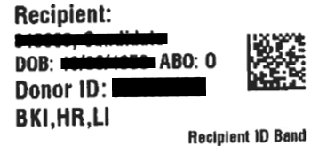
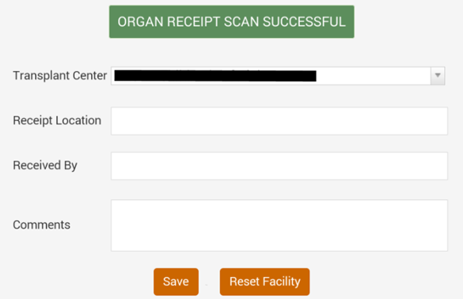
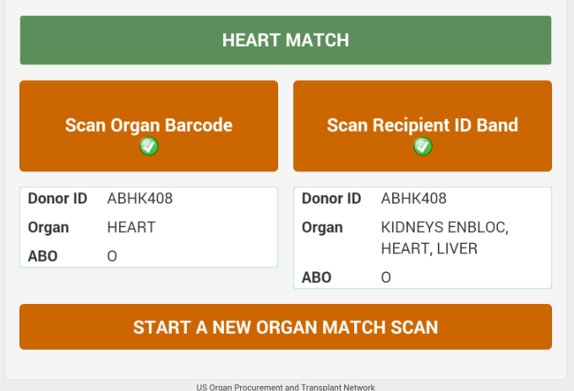
TransNet^{sm} – Beta Test – Transplant Centers
Print Recipient ID Band
Scan Receipt of the Organ
Match Organ and Recipient
Notes:
Transplant hospital responsibilities
Print recipient ID band from DonorNet
Scan receipt of the organ package when it arrives at the transplant hospital
Scan to match the organ to the recipient
October 2014 – January 2015
Proof of concept test
Monthly feedback to the TransNet^{sm} team
Center must be prepared for both TransNet^{sm} packaged organs as well as organ packaged and labeled using the current system
Feedback and discovery to inform and shape the future
Piedmont Hospital in Atlanta, GA (Beta test participant)
On October 9, 2014, became the first transplant center in the country to use TransNet^{sm} system in an actual case.
19:30 – Printed and attached the Recipient ID band
19:54 – Scanned receipt of the liver organ container
21:59 – Successfully scanned and matched the liver and the recipient
Have about 3 others almost ready to start
Challenges
DonorNet access
Transplant staff in OR at time of transplant
Printing recipient ID band

Slide 11
TransNet^{sm} – Next Steps
Enhancements to Android application
Based on feedback from beta test
UNOS IT/Vendor
Voluntary Nationwide deployment
Train the Trainer sessions
Multiplatform application
Refine the transplant hospital functionality
Based on feedback from beta test
Discovery project
Hope Act
Notes:
Will start train the trainer sessions in March
Looking at building IOS and possibly windows surface

Slide 12
Questions?
Theresa Daly, FNP Committee Chair
THD9003@nyp.org
Susan Tlusty, Committee Liaison
Susan.Tlusty@unos.org

