Slide 1
Pediatric Training and Experience Requirements in the Bylaws
OPTN/UNOS Board of Directors
Eileen Brewer, MD, Chair
William Mahle, MD, Vice Chair
November 12-13, 2014

Slide 2
The Problem
Pediatric experience not required for key personnel at programs that perform pediatric transplants.
Notes:
In the current Bylaws, the primary surgeon and primary physician are not required to have pediatric experience in order to serve as key personnel in programs that perform pediatric transplants.

Slide 3
The Charge
2010 MPSC Annual Goal: Develop qualification criteria for pediatric program approval
Strategic Plan Goal 4: Promote patient safety
Objective B: Maintain high level of medical expertise
Strategy: Ensure physicians and surgeons have current, relevant expertise
Key Initiative: Develop separate program requirements for pediatric programs
Notes:
Although rare, the MPSC has received applications for key personnel at free-standing children’s hospitals from applicants without pediatric transplantation training or experience. Since the current Bylaws do not define a pediatric program or require that applicants have pediatric experience to serve as key personnel, MPSC members are obligated to approve these applications despite their reservations. Programs that predominantly perform adult transplants are also not prohibited from performing the occasional pediatric transplant, regardless if key personnel have pediatric training or experience. The Bylaws’ silence on pediatric program requirements means that there is not a universal standard of quality pediatric care, which, in the most rare and serious of circumstances, could pose a risk to patient safety.
In 2010, the MPSC included developing qualification criteria for pediatric organ transplant program approval as an annual goal. In 2012, the Board of Directors included developing separate program requirements for pediatric programs as a key initiative under Goal 4: Promote Patient Safety of the OPTN/UNOS Strategic Plan, and that key initiative remains in place. The Board has charged the Pediatric Committee with developing a Bylaws proposal that fulfills this key initiative.

Slide 4
Project Timeline
93-02
Notes:
The MPSC, my Committee, and others have attempted to resolve this since 1993, but efforts have continually failed because of an inability to achieve consensus on proposed requirements. While the association between center case volume and recipient and graft outcomes is well-documented in the literature, the data does not provide evidence for minimal case volume requirements. The Committee attempted to collect such data in 2002 when it surveyed 257 transplant programs, which represented 82% of the total pediatric transplants performed from 1998 to 2001. While valuable as the first census of programs performing pediatric transplants, the results did not yield significant predictors of good transplant outcomes. In 2006, the Committee redirected its efforts to President Sue McDiarmid’s initiative to reduce pediatric waiting list mortality, which resulted in three significant organ allocation policy changes.
Since 2012, the Committee has been diligently working on a Pediatric Bylaws proposal. In the spring of 2013, the Committee sent a formal memo to the organ-specific Committees and the professional societies requesting their feedback on important Bylaw development questions, including how to define a pediatric program and how to set appropriate case volume requirements. In the fall of 2013, the Committee provided an update at the Regional Meetings on our progress developing initial requirements.

Slide 5
Quality vs. Access: Why Achieving Consensus is Difficult
Societies supportive of more stringent case volume criteria
Organ-specific
Stratified by age, size
Limited timeframe of achievement
Organ-specific Committees and Regional Meeting attendees concerned about restricting access
Notes:
The reason that achieving consensus is difficult is that proposed requirements must balance the competing interests of quality, including patient safety, and access to transplantation. The most contentious aspect of the proposal has been the case volume requirements for the primary surgeon. The professional societies have generally expressed support for more stringent case volume criteria, including greater volume that is stratified by age, size, and other clinically-relevant factors (such as experience placing intraperitoneal kidney transplants in small children or congenital heart surgery certification for infant heart transplant surgeons). The OPTN/UNOS organ-specific Committees and Regional Meeting attendees are concerned about restricting access to transplantation for pediatric patients. The Committee’s first proposal included greater, stratified case volumes that must have been attained in the past five years. We have since modified the proposal to ensure access for pediatric patients while still promoting quality and protecting patient safety.

Slide 6
Current Proposal: Public Comment January 2015
Quality | Access
Programs performing any transplants in <18 yr old | Lifetime experience
Organ-specific case volumes | No stratifications
Requires currency | Conditional Pathway
 | Delayed implementation
Surgeon Case Volume
Heart 8 | Liver 18
Kidney 12 | Lung 4
Notes:
The Committee believes this proposal is our most successful attempt in 20 years at achieving consensus on the requirements for a pediatric program, and we plan to submit it for Public Comment in January 2015. Any approved organ transplant program performing at least one transplant in a patient less than 18 years old would be required to apply and be approved for a “pediatric component.” This approval would only require that the program designate a primary surgeon and a primary physician with the appropriate pediatric training or experience. Primary surgeon case volume requirements are organ-specific and vary depending on the frequency of the procedure. While case volumes may be attained at any time during the surgeon’s career, the proposal requires currency of experience, as already defined in the Bylaws. Pediatric case volume requirements are not further stratified by age, size, or any other factor. Programs will have several years to prepare for the implementation of the Bylaws changes, and primary surgeons may take advantage of a Conditional Pathway while they work to achieve the required case volume.

Slide 7
Number of centers meeting the proposed pediatric criteria, 1/1/05-7/31/14
Organ Transplanted | Centers with >1 Pediatric Transplant | Number of Centers Meeting Criteria*
 | N | N | %
Kidney | 171 | 112 | 65.5
Liver | 88 | 51 | 58.0
Heart | 82 | 52 | 63.4
Lung | 42 | 20 | 47.6
* Criteria:
Kidney: At least 12 transplants in recipients <18 years
Liver: At least 18 transplants in recipients <18 years
Heart: At least 8 transplants in recipients <18 years
Lung: At least 4 transplants in recipients <18 years
Notes:
In our initial proposal, only 41% of all centers that had performed at least one pediatric transplant would have been approved for a pediatric component. After modifying this proposal in an effort to preserve access, while still promoting patient safety, we now estimate that 61% of centers would meet criteria if this proposal were implemented today.
Speaker’s note: 61% is likely an underestimate since any program that had performed at least one pediatric transplant in the past 10 years was included in the analysis.

Slide 8
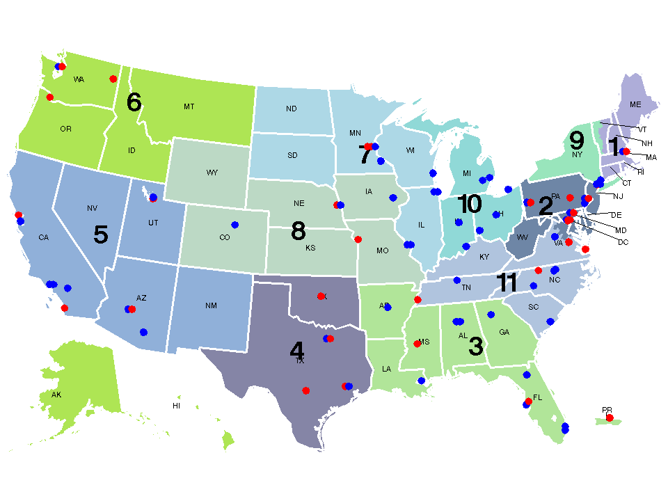
Geographic location of centers performing pediatric heart transplants, 1/1/05-7/31/14
Represents centers with > 8 pediatric transplants (N=52)
Represents centers with < 8 pediatric transplants (N=30)
Notes:
Total 82 ctrs
The total number of pediatric heart transplants performed across these 82 centers was 3,440 and ranged from 1 to 193.
52 ctrs with 8 or more ped txs (63.4%) meet the criteria.

Slide 9
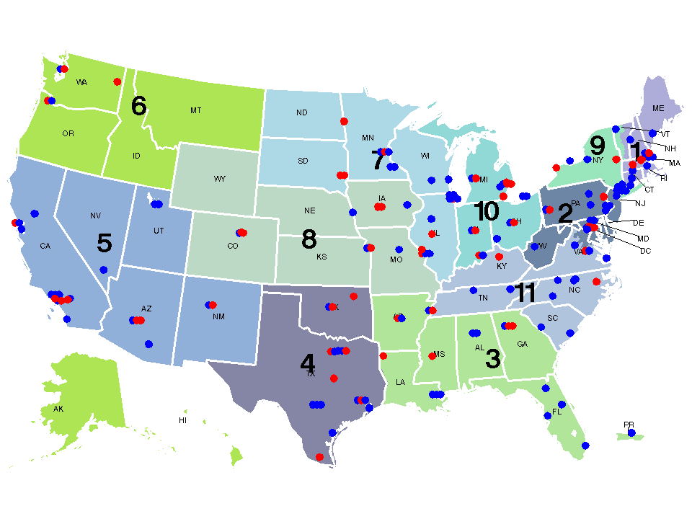
Geographic location of centers performing pediatric kidney transplants, 1/1/05-7/31/14
Represents centers with > 12 pediatric transplants (N=112)
Represents centers with < 12 pediatric transplants (N=59)
Notes:
171 centers performed at least one kidney transplant in pediatric recipients (age at transplant <18).
The total number of pediatric kidney transplants performed across these 171 centers was 7,599 and ranged from 1 to 230.
112 of the 171 centers (65.5%) had at least 12 pediatric kidney transplants, which meets the criteria.

Slide 10
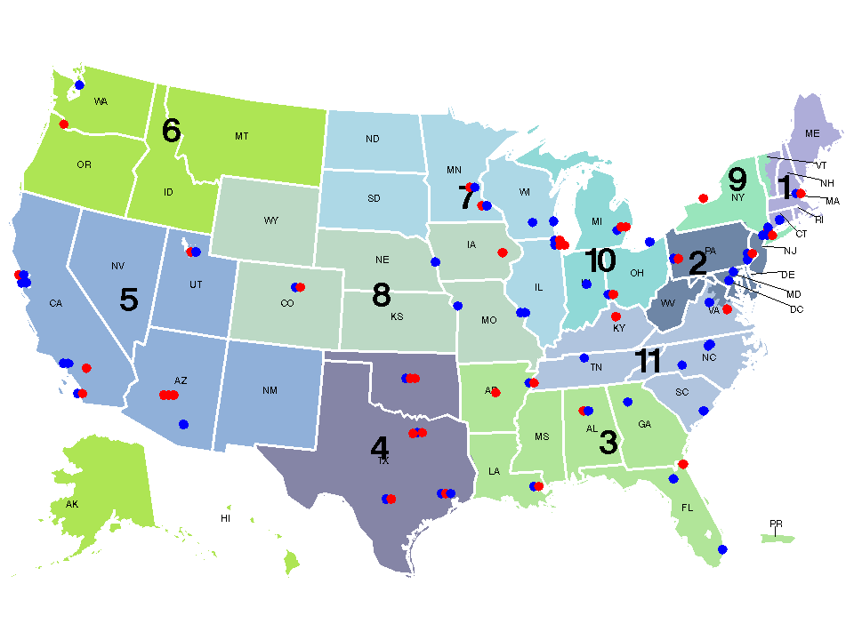
Geographic location of centers performing pediatric liver transplants, 1/1/05-7/31/14
Represents centers with > 18 pediatric transplants (N=51)
Represents centers with < 18 pediatric transplants (N=37)
Notes:
Total 88 ctrs
The total number of pediatric liver transplants performed across these 88 centers was 5,055 and ranged from 1 to 314.
51 of the 88 ctrs (58.0%) had 18 or more ped txs, which meets the criteria.

Slide 11
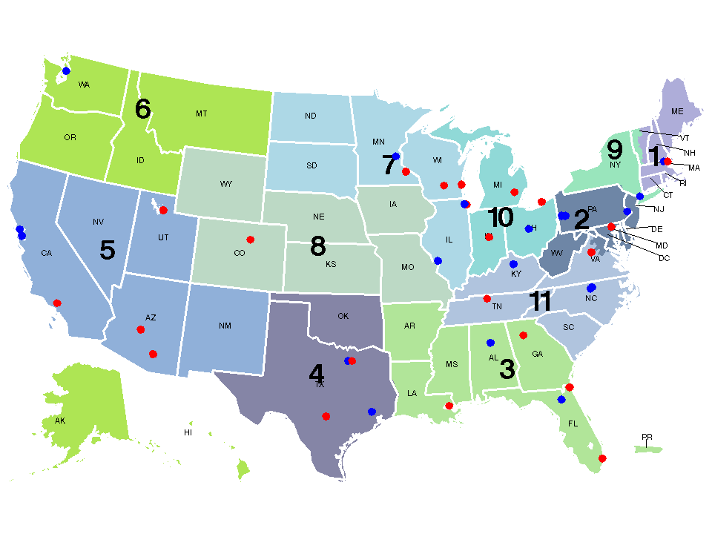
Geographic location of centers performing pediatric lung transplants, 1/1/05-7/31/14
Represents centers with > 4 pediatric transplants (N=20)
Represents centers with < 4 pediatric transplants (N=22)
Notes:
Total 42 ctrs
The total number of pediatric lung transplants performed across these 42 centers was 510 and ranged from 1 to 123.
20 ctrs with 4 or more ped txs (47.6%).

Slide 12
Contacts
Eileen Brewer, MD Committee Chair ebrewer@bcm.edu
Christine Flavin, MPH Committee Liaison christine.flavin@unos.org

