Slide 1
National Webinar:
Proposed Modification of the Adult Heart Allocation System
Thoracic Organ Transplantation Committee
February 2, 2016
If you are logged into the webinar, please enter the audio PIN
Please put your phone on MUTE and do not place this call on HOLD

Slide 2
Webinar Objectives
Present the Thoracic Organ Transplantation Committee’s proposal to modify the adult heart allocation system
Permit attendees to ask questions
Encourage attendees to attend regional meetings and submit public comment

Slide 3
Spring 2016 Public Comment
Opened January 25
Closes March 25
Proposals are posted on the OPTN website under “Governance” tab
https://optn.transplant.hrsa.gov/governance/public-comment/adult-heart-allocation-changes/

Slide 4
Spring Regional Meeting Schedule
Region | Date | Location
10 | Friday, February 5 | Dayton, OH
1 | Monday, February 8 | Worcester, MA
4 | Friday, February 12 | Dallas, TX
8 | Friday, February 12 | Kansas City, MO
7 | Thursday, February 18 | Chicago, IL
6 | Friday, February 19 | Spokane, WA
11 | Friday, February 19 | Charlotte, NC
9 | Wednesday, March 9 | New York, NY
2 | Friday, March 11 | Philadelphia, PA
3 | Friday, March 11 | Atlanta, GA
5 | Thursday, March 17 | Las Vegas, NV

Slide 5

Asking Questions
Throughout the webinar, you can type your questions into the Questions box and the moderators will address them during the Q&A

Slide 6
Proposed Modification of the Adult Heart Allocation System

Slide 7
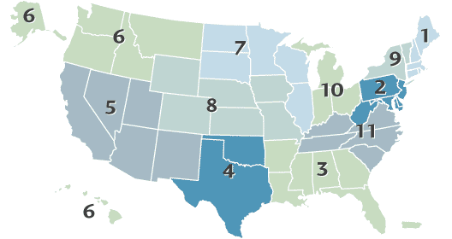
Current Allocation Policy
Adult Candidate Prioritization:
Status 1A
MCS
  30 days elective VAD time
  TAH
  IABP
  ECMO
VAD with complication
Mechanical ventilation
PAC + 1 high-dose or multiple inotropes
Exception
Status 1B
LVAD/RVAD
Continuous inotropes
Exception
Status 2
Those who do not meet 1A or 1BB
Zone C
1500 Miles
Zone A
500 Miles
Zone B
1000 Miles
Geographic Allocation
Local: Status 1A, Status 1B
Zone A: Status 1A, Status 1B
Local: Status 2
Zone B: Status 1A, Status 1B
Zone A: Status 2
Zone B: Status 2
Etc…

Slide 8
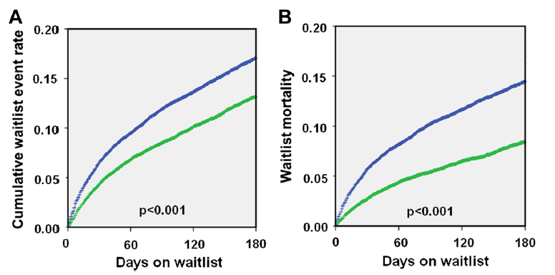
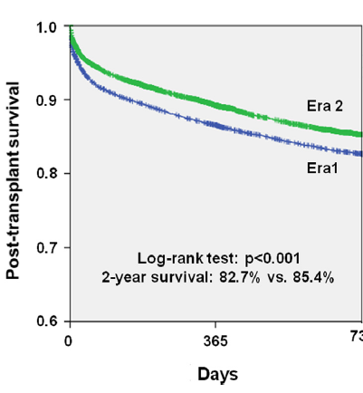
Impact of 2006 Policy Changes
Waitlist Death or Delisting
Waitlist Mortality
Post-Transplant Survival
Blue: 1/99-7/06
Green: 7/06-4/12

Slide 9
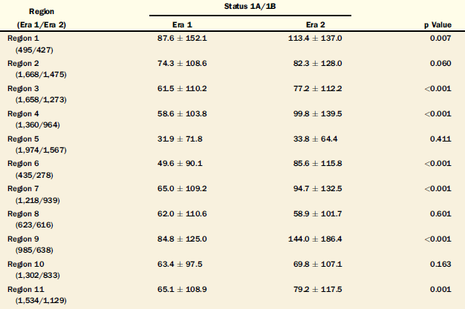
Regional Differences in 1A/1B Waiting Times Before & After 2006 Policy Change
JACC HF 2014; 2:166-77

Slide 10
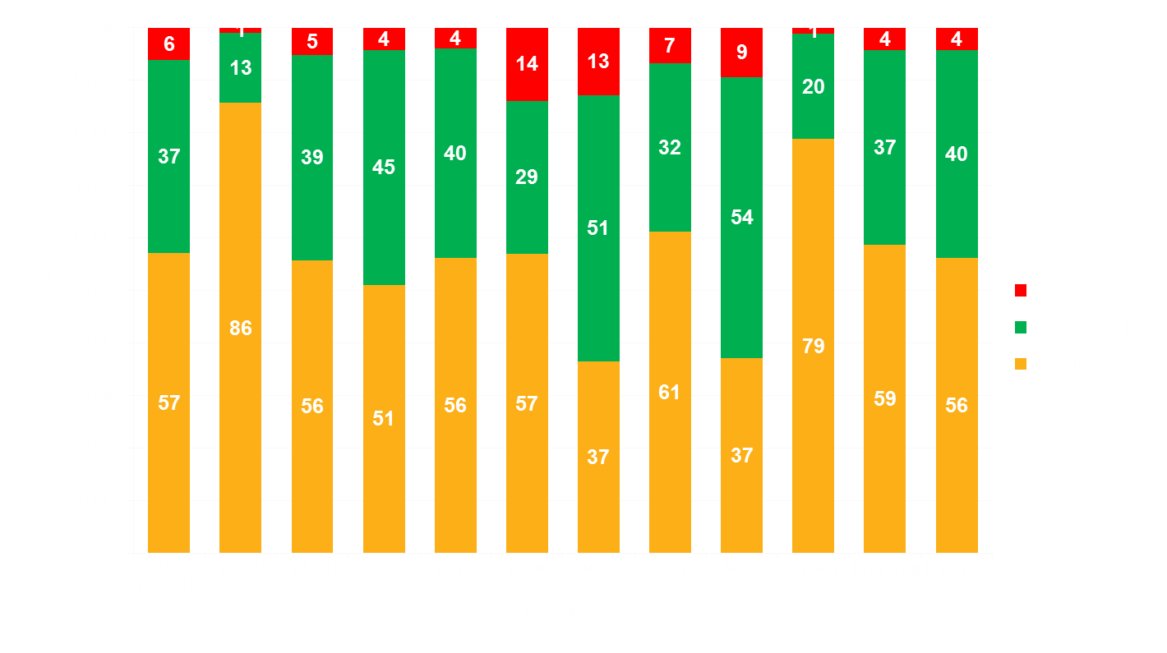
Regional Status Disparities

Slide 11

Geographical Challenges in Heart Allocation
Region 2
A status 1B patient in NYC would be transplanted before a 1A patient 15 miles away in Newark
Region 9

Slide 12
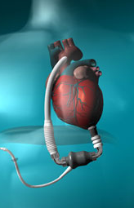
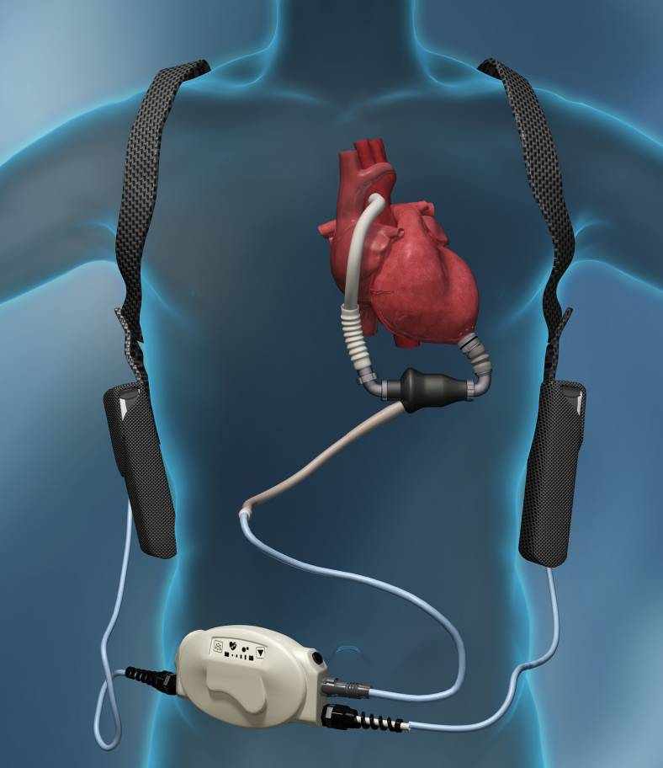
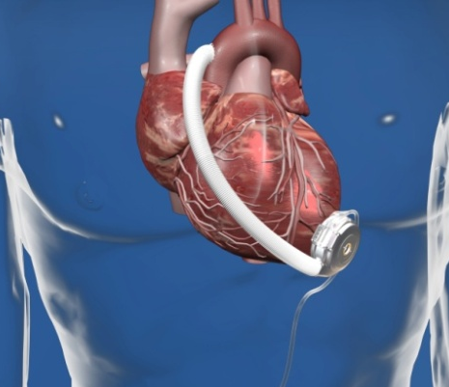
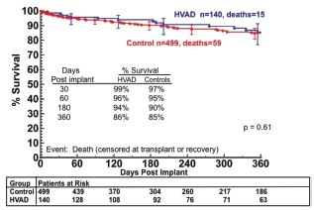
Durable MCS Devices: Continuous Flow
Circulation 2012; 125:3191-3200
Ann Thorac Surg 2011; 92:1406-13
Circulation 2012; 125:3191-3200

Slide 13
Adults Bridged with MCS by Year & Device Type
JHLT 2014 Oct; 33(10): 996-1008

Slide 14
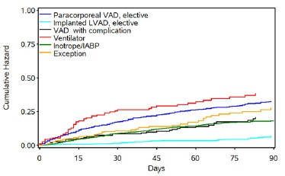
Waitlist Mortality for 1A Criteria
Cardiac Recipient Prioritization:
Status 1A
MCS
  30 days elective VAD time
  TAH
  IABP
  ECMO
VAD with complication
Mechanical ventilation
PAC+ 1 high-dose or multiple inotropes
Exception
J Am Coll Cardiol 2012;60:36-43

Slide 15
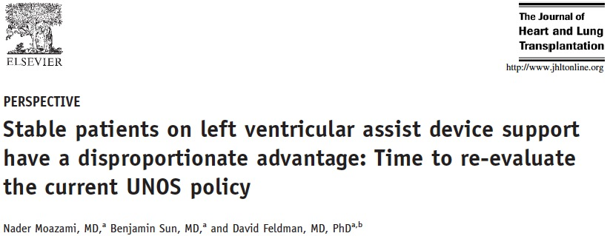
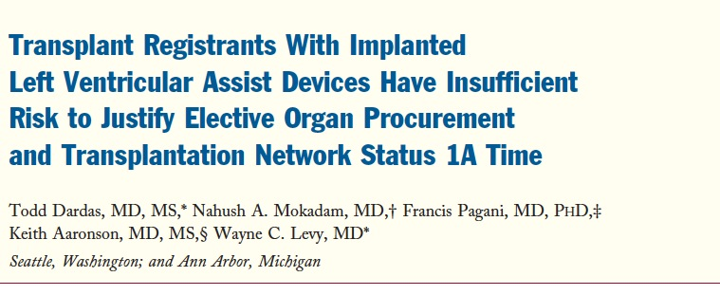
J Heart Lung Transplant 2011;30:971-4
J Am Coll Cardiol 2012;60:36-43

Slide 16
Regional Variability in VAD Use and Complications
Status 1A(a): VAD<30 days, TAH, IABP, ECMO
Status 1A(b): Device Complication
Status 1A(b): Device Complication
52.1
31.8
7.2
17.6
44.7
40.6
33.6
36.9
30.4
30.6
28.8
41.4
23.5
22.4
23.1
37.2
21.3
25.1
25.9
19.0
14.0
25.4
Regional variability in the use of VAD complications as justification for 1A listing
Uniform definitions of complications will make access more equitable
Regional variability in use of MCS as BTT inherently disadvantages some patients
Cannot be rectified unless uniform criteria for BTT VAD are implemented
OPTN Data 2011

Slide 17
Problems with the Current System
Status 1A candidates are 3x more likely to die on the waiting list than candidates in any other status
High # of exception requests indicates certain candidates not served well by current system
Policy out of date re: increased use of MCSDs and associated complications
Current geographic sharing scheme is inequitable and inconsistent with the Final Rule

Slide 18
Solutions Considered by Thoracic Committee
No change
Alter the current 3-status system
Develop an expanded status system
Develop a formal heart allocation score

Slide 19
How was the proposal developed?
Identify patients with high waitlist mortality
Considerations: waitlist mortality, transplant rates and post-transplant survival
Define “criteria” for subjective decisions based upon objective data elements and physiological principles
Explore options for broader sharing for the sickest patients
Integrate pediatric allocation
Model the above and hope/pray that the data is interpretable, accurate and explainable

Slide 20
Development of Additional Statuses

Slide 21
Straw Man Development
Reviewed waitlist and post-transplant mortality in SRTR stratified by disease process
Exception classification
Clustered diseases based upon mortality into like cohorts
TSAM (listed patients from 2009-2011) to determine predicted impact on tx rates, WL mortality, PT survival

Slide 22
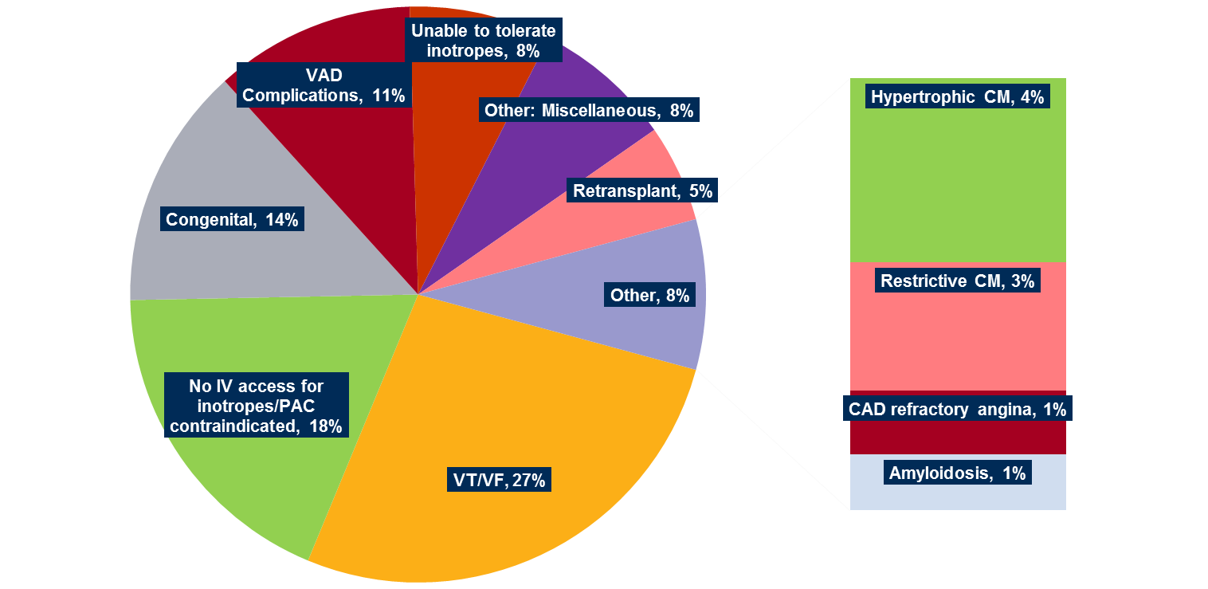
Categories for Adult 1A Exceptions
N=640

Slide 23
Proposed New Statuses: High Level
Current Status | Proposed Status
1A | 1
 | 2
 | 3
1B | 4
2 | 5
 | 6
Proposed statuses 1-3 are generally defined by current status 1A criteria
Proposed status 4 is generally defined by current status 1B criteria
Proposed status 5-6 are generally defined by current status 2 criteria

Slide 24
Proposed Statuses 1-3
Status | Criteria
1 | ECMO Continuous Mechanical ventilation Non-dischargeable (surgically implanted) VAD MCSD with life-threatening ventricular arrhythmia
2 | Intra-aortic balloon pump Ventricular tachycardia/ventricular fibrillation, mechanical support not required MCSD with device malfunction/mechanical failure Total artificial heart Dischargeable BiVAD or RVAD Acute circulatory support
3 | Dischargeable LVAD for up to 30 days Multiple inotropes or single high-dose inotropes with continuous hemodynamic monitoring MCSD with device infection MCSD with hemolysis MCSD with pump thrombosis MCSD with right heart failure MCSD with mucosal bleeding MCSD with aortic insufficiency

Slide 25
Proposed Statuses 4-6
Status | Criteria
4 | Stable LVAD candidates not using 30 day discretionary period Inotropes without hemodynamic monitoring Diagnosis of congenital heart disease (CHD) Diagnosis of ischemic heart disease with intractable angina Diagnosis of hypertrophic cardiomyopathy Diagnosis of restrictive cardiomyopathy Diagnosis of amyloidosis Retransplant
5 | Combined organ transplants
6 | All remaining active candidates

Slide 26
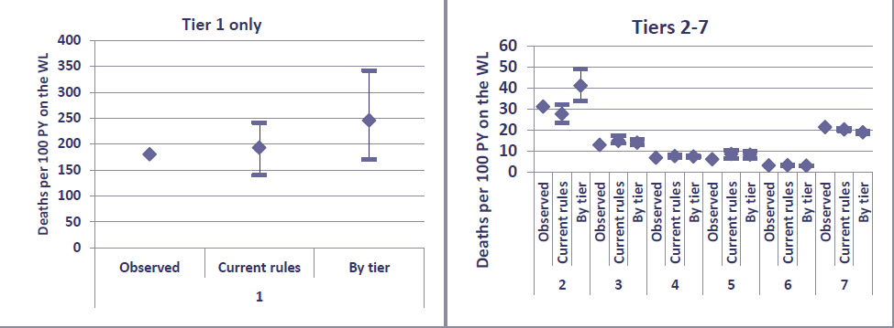
Modeled Waitlist Mortality

Slide 27
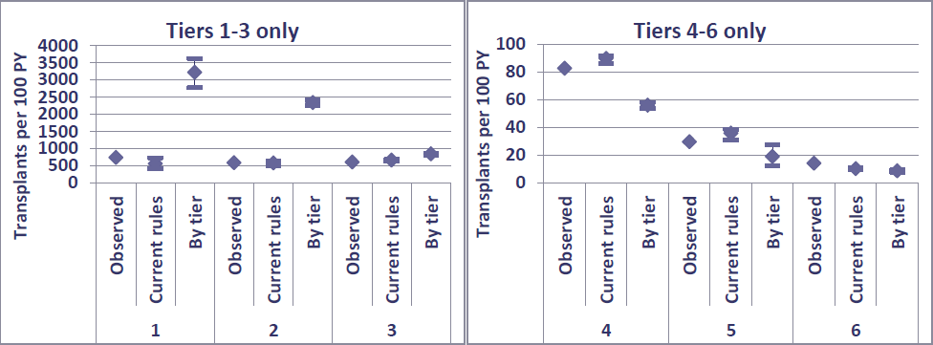
Modeled Transplant Rates
* Note different values on “y” axis

Slide 28
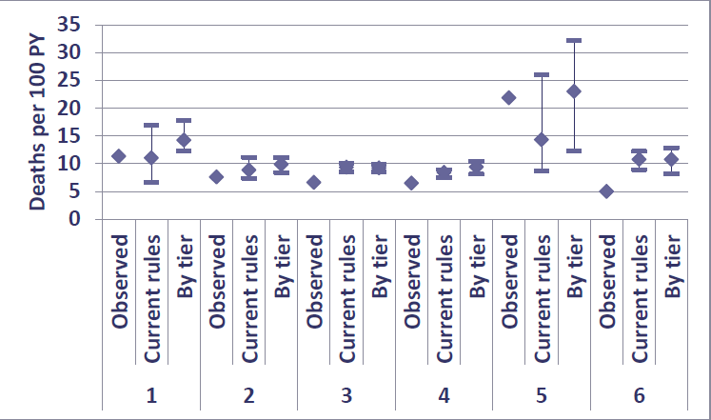
Modeled 24-Month Post-Transplant Mortality

Slide 29
Device Complications

Slide 30
Lack of MCS Complication Definitions May Lead to Inequitable Access
Status 1A Justifications for VAD Infection Submitted in 2010, Stratified by Region

Slide 31
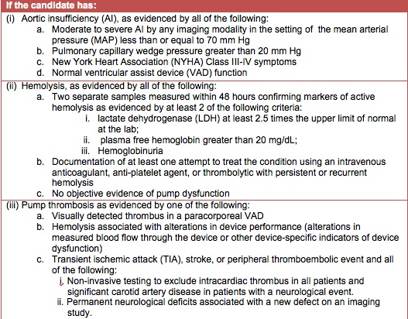
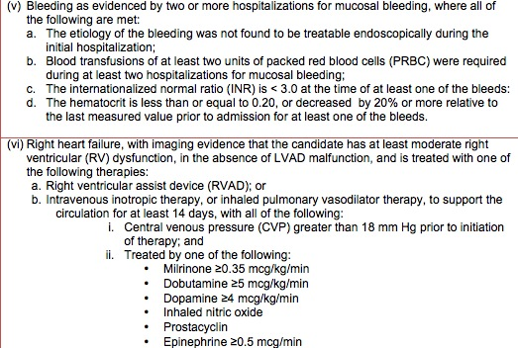
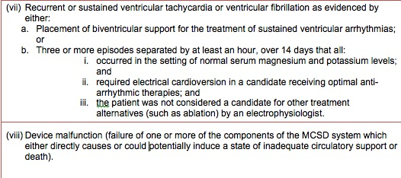
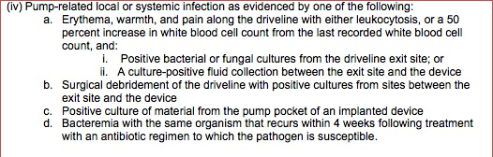
“Criterion (b) Guidance Document”: Device Complications

Slide 32
Development of Broader Sharing

Slide 33
Broader Sharing Background
Goal: increase organ access for the sickest patients
Considered 4 models for cardiac sharing
Modeling was performed sequentially to prioritization

Slide 34
Two Preferred Modeled Sequences
Broader sharing 1/2A*
Candidate status | Location
Status 1 adult + Status 1A ped | DSA + Zone A
Status adult + Status 1A ped | Zone B
Status 2 adult | DSA + Zone A
Status 2 adult | Zone B
Status 3 adult + Status 1B ped | DSA
Status 4 adult | DSA
Status 3 adult + Status 1B ped | Zone A
Broader sharing 1/2B
Candidate status | Location
Status 1 adult + Status 1A ped | DSA + Zone A
Status 1 adult + Status 1A ped | Zone B
Status 2 adult | DSA + Zone A
Status 2 adult | Zone B
Status 3 adult + Status 1B ped | DSA
Status 3 adult + Status 1B ped | Zone A
Status 4 adult | DSA
* Selected sharing strategy

Slide 35
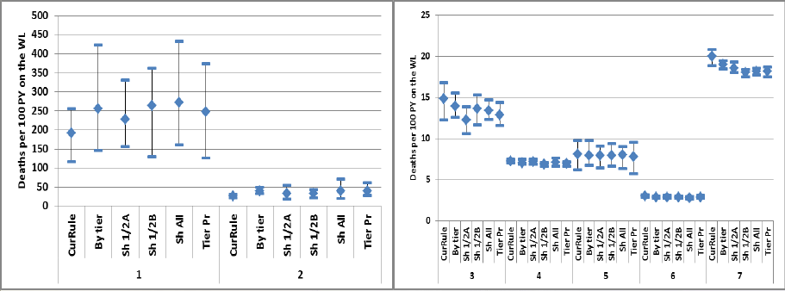
Impact of Broader Sharing: Wait List Mortality
Share 1/2A: Share to Zone B for Tier 1, then to Zone B for Tier 2 before offers to Tier 3
Share 1/2B: Similar to above but with sharing to Zone A amongst Tier 3 prior to Tier 4

Slide 36
Number of Waitlist Deaths by Simulation and Status
 | Current Rule |  |  | Broader Sharing
Status | Ave | Min | Max | Ave | Min | Max
1 | 16 | 11 | 19 | 6 | 4 | 9
2 | 16 | 12 | 18 | 5 | 3 | 9

Slide 37
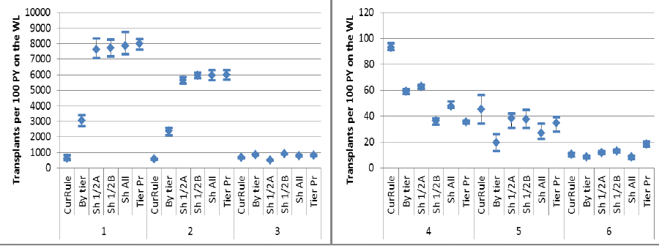
Impact of Broader Sharing: Transplant Rates

Slide 38
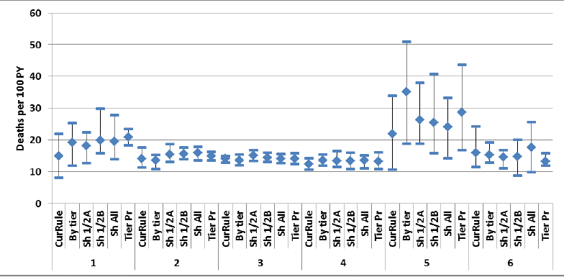
Impact of Broader Sharing: 1-year post-transplant mortality

Slide 39
Impact on Pediatric Candidates
No negative impact anticipated
Potential for positive impact on pediatric candidate access to transplant
Modeling results for 6 urgency statuses with broader sharing:
  Increased transplant counts for pediatric candidates
  Increased transplant rates for status 1A pediatric candidates
  Overall death counts decrease slightly

Slide 40
Sensitized Candidates

Slide 41
CPRA distribution: Adult WL candidates (N=7,552)
Candidates ever waiting 1/1/11-6/30/13; limited to candidates at heart programs with any UAs reported
Barriers:
Large amount of missingness (~25% of programs)
0% PRA may represent unsensitized or not reported
CPRA based upon renal calculator
No standardization on testing methodology
No standardization of minimum threshold to define a “significant” antibody

Slide 42
Summary & Conclusions

Slide 43
Summary & Conclusions
Current candidate prioritization and donor allocation is not contemporary resulting in inequities
Current allocation rules do not meet Final Rule criteria for broader sharing
The Thoracic Committee has devised a 6 status prioritization scheme with broader sharing that appears to improve timely access to transplantation for the sickest on the waiting list
We intend to have the proposal out for public comment in the Spring, 2016
Depending on public comment feedback, we will either bring the proposal to the Board in June 2016 or go for a second round of public comment in August 2016

Slide 44
Anticipated Controversies
Should ECMO be prioritized in the highest status?
Should TAH be placed in Status 2?
How can redesign favorably impact the highly pre-sensitized and encourage data submission to inform future change?
Should we extend or eliminate 30-day elective VAD times?
Will the community agree upon the selected physiological principles that qualify a patient for inotrope use?
Will the “lumping” of CHD and restrictive CM stand up to public comment
How will broader sharing be viewed by the public?
Preference for heart allocation score
Transition candidates from old system to new system

Slide 45
Question and Answer Session

Slide 46
Asking Questions
Type your questions into the Questions box and the moderator will read them aloud

