Slide 1
Guidance on Pediatric Transplant Recipient Transition & Transfer
Pediatric Transplantation Committee

Slide 2
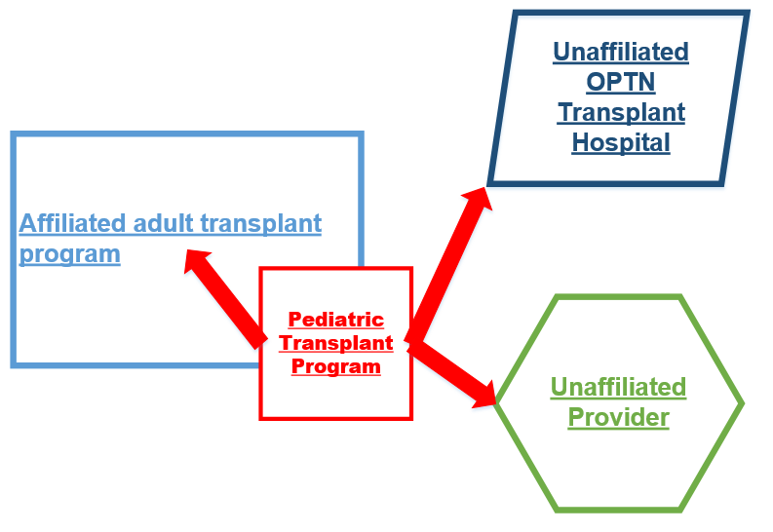
Transfer Scenarios
Notes:
Goal of pediatric transplantation: to restore health to critically ill children with the hope for long-term survival into adulthood.
Transition = gradual assumption of responsibility for self-care
Transfer = recipient being cared for by another provider
There are three prevalent transfer scenarios seen with pediatric recipients. Recipient preference, payer factors, and where a recipient lives all impact where the recipient may be transferred.
An adult transplant program affiliated with the pediatric transplant program
Another OPTN transplant hospital
An unaffiliated provider

Slide 3
What problem will the proposal solve?
Suboptimal transition & transfer associated with non-adherence and graft loss
Most frequent lost to follow-up in pediatric kidney and liver recipients
Impacts the integrity of transplant outcome data
Notes:
Effective transition and transfer practices help ease the move from pediatric to adult clinics, and can lay the ground work for positive transplant outcomes.
Suboptimal transition and transfer processes for pediatric transplant recipients can increase the risk of recipients’ not adhering to their follow-up care and eventually losing their graft.
Breakdowns in transition and the transfer to adult medical care may also cause more recipients to be reported as lost to follow-up on OPTN data collection forms. The highest lost to follow-up rates were observed in pediatric kidney and liver transplant recipients.
Understanding pediatric transplant outcomes is critical for the pediatric transplant community:
OPTN data are used by providers to communicate realistic goals regarding transplantation to patients and their families or guardians.
OPTN data drive policy decisions.

Slide 4
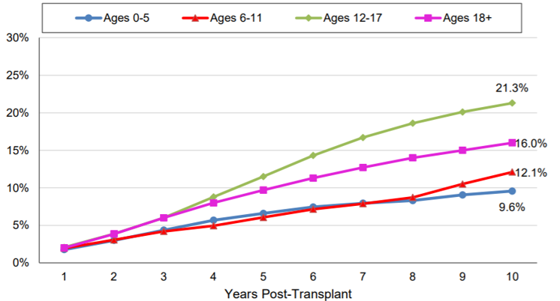
Lost to Follow-up Rates at 1 through 10 Years after Transplant for Kidney Transplants Performed during 2000 - 2010 by Age at Transplant
Notes:
This slide profiles the lost to follow-up rates within 10 years for kidney recipients transplanted less than 18 years old.
The problem is not just for adolescent recipients.

Slide 5
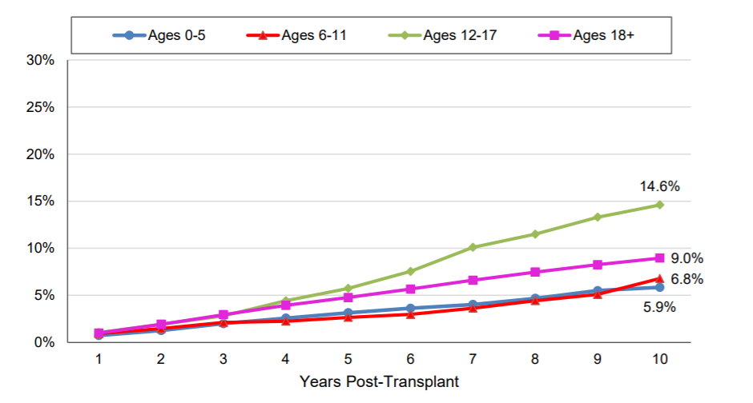
Lost to Follow-up at 1 through 10 Years after Transplant for Liver Transplants Performed during 2000 - 2010 by Age at Transplant
Notes:
This slide profiles the lost to follow-up rates within 10 years for liver recipients transplanted less than 18 years old.
The problem is not just for adolescent recipients.

Slide 6
What are the proposed solutions?
Goals:
Support improvements in transplant outcomes
Improve the transition and transfer process
Reduce number of recipients who are lost to follow-up
Proposed Solution: Guidance to improve pediatric recipient transition and transfer
Recommendations based on survey responses from the transplant community
Notes:
Many recipients lost to follow-up are the result of breakdowns in the transition and transfer to adult medical care. The goals of this proposal was to develop guidance that can:
support improvements in transplant outcomes by reducing instances of graft loss from non-adherence, and
improve the transition and transfer process for pediatric recipients
reduce the reporting of lost to follow-up for pediatric transplant recipients
An online survey was conducted in early 2018. The responses were linked to transplant programs with average or better than average lost to follow-up rates. Also considered were published resources available to the pediatric community on transition and transfer practices. The guidance includes numerous recommendations for pediatric transplant teams and the adult providers they partner with. As mentioned earlier, the highest lost to follow-up rates were observed in kidney and liver transplant recipients. However, the Subcommittee felt the practices outlined could be applied to all pediatric transplant programs.

Slide 7
Examples
Pediatric transplant team
Prepare recipient and family members/guardians
Consider transfer to an adult provider within the same institution
Encourage and guide recipients’ independence and self-responsibility
Reinforce that recipients must become strong advocates
Provide a portable, concise, up-to-date summary of medical/ surgical history and detailed list of medications
Notes:
The next slides provide a few examples of practices for pediatric transplant teams and accepting adult providers:
Pediatric transplant team
Prepare recipient and family members/guardians
Consider transfer to an adult provider within the same institution
Encourage and guide recipients’ independence and self-responsibility
Reinforce that recipients must become strong advocates
Provide a portable, concise, up-to-date summary of their medical/ surgical history and a detailed list of their medications

Slide 8
Examples
Accepting adult providers
Educate staff regarding childhood and adolescence psychosocial development
Seek knowledge about congenital conditions that lead to organ failure in pediatric patients
Recipients from pediatric programs may need time to adjust
Maintain ongoing communication with the pediatric programs
Notes:
Accepting adult providers
Provide staff education regarding childhood and adolescence psychosocial development, and the impact of childhood chronic disease on development.
Be knowledgeable about congenital conditions that lead to organ failure in childhood and that may rarely been seen in adult patients.
Be mindful that transplant recipients who are transferring into their practice may need time to fully adjust to the more rapid pace of an adult clinic
It is important to maintain ongoing communication with the transplanting hospital to improve recipient transfers. If an provider is not affiliated with an OPTN member transplant hospital, be committed to provide needed recipient health information back to the transplanting hospital.

Slide 9
How will members implement this proposal?
Resource to enhance:
Transplant outcomes
Transition and transfer practices
Data submission
Transplant programs will be the best judge on how to implement
Notes:
This guidance is an optional resource for transplant staff. The benefits may include improvements in transplant outcomes, transition and transfer practices, and data submission to the OPTN.
If a transplant program implements the practices contained in this guidance, they may need to:
Enhance or refine their transition practices to be recipient-driven.
Develop and maintain relationships with providers that accept pediatric recipients for on-going medical care.
Develop internal policies or procedures to ensure accepting providers receive the information needed for transfer.
Allocate additional resources to obtain recipient health information from outside providers. This may take the shape of additional staff time to contact outside providers and report the information to the OPTN.

Slide 10
Feedback requested
In what ways have you seen recipients (transplanted <18 years old) well prepared, or ill prepared, for transfer to adult medical care?
Is there specific information about the recipient, or specific transfer practices that have led to an optimal hand-off from a pediatric program to your program?
What practices help you share the recipient’s health information back to the pediatric transplant program for OPTN data submission?
Do you currently use, or have you considered, any non-conventional models of transfer to adult medical care?
Notes:
Clinical staff in adult medical care are key stakeholders in the transition and transfer process. Staff members who receive recipients from pediatric transplant programs are encouraged to share feedback on their transfer experiences.
In what ways are recipients (transplanted <18 years old) well prepared or ill prepared for transfer to adult medical care?
Is there specific information about the recipient, or specific transfer practices that have led to an optimal hand-off from a pediatric program to your program?
What practices help you share the recipient’s health information back to the pediatric transplant program for OPTN data submission?
Recipient transfer scenarios may not fit neatly into the three types profiled in the guidance document.
Do you current use, or have you considered, any non-conventional models of transfer to adult medical care, e.g.: transfer routine medical care to a provider not affiliated with a transplant hospital (perhaps nearby to the recipient’s place of residence) and arrange for periodic outpatient evaluations with a transplant program outside your institution?

Slide 11
Questions

