Slide 1
OPTN/UNOS Transplant Coordinators Committee
Spring 2019

Slide 2
Committee Project
TCC Learning Series
Strategic Goal: Increasing the number of transplants
Target Audience: OPOs and transplant centers/transplant professionals
Promotes broader sharing of practices
Notes:
The Transplant Coordinators Committee charge is to consider issues related to the coordinated efforts of professionals involved in organ procurement and allocation. We also consider how proposed policy and bylaw revisions will impact professionals, candidates, recipients, living donors, and their families
And also work to improve the quality, efficiency and effectiveness of procurement and transplant coordination though OPTN initiatives and policies.
The Transplant Coordinators Committee began producing the TCC Learning Series in 2017. Five offerings focused on introductory topics for new transplant professionals. Since increasing the number of transplants continues to be a top priority goal in the OPTN strategic plan, the committee will continue this series in 2019. This year’s series will provide broader sharing of practices for both OPOs and transplant centers. Sharing practices allow transplant professionals to see how their colleagues are addressing common issues and barriers to transplant and replicate these ideas. The TCC Learning Series will highlight processes that mitigate waitlist mortality while increasing the number of transplants performed and give transplant professionals information/tools/and resources they can use to make change within their organizations.
The 2018 Learning Series was divided into 4 quarterly releases. The 2019 learning series releases will follow the same format.

Slide 3
2018 Learning Series Topics
Available now in UNOS Connect
Leveraging UNet Reports to Improve Practice
PHS Increased Risk
Donor Management
Explaining the Candidate Registry
Notes:
Here are the topics for 2018
1. Leveraging UNet Reports to Improve Practice – January/February 2018
This e Learning module explains the potential of UNet reports by demonstrating what reports would be helpful for transplant coordinators and how to use them.
2. PHS Increased Risk – Released April 2018
This is a list of resources about PHS Increased Risk that offer more information about what this designation means, why it is important, and how to discuss this topic with potential recipients.
3. Donor Management– Scheduled release – end of July 2018
This offering emphasizes effective practices to facilitate donor management and organ allocation. These practices are intended to help coordinators develop and improve ways to enhance communication and collaboration between transplant center and OPO coordinators without compromising recipient outcomes.
4. Explaining the Candidate Registry – Scheduled release October 2018
Again, the actual content for this instructional event has not been developed but the intent will be to educate coordinators on how to talk with patients and provide examples of how to better explain the waitlist (Candidate Registry) to their patients.
The 2019 learning series topic and modules are under development.

Slide 4
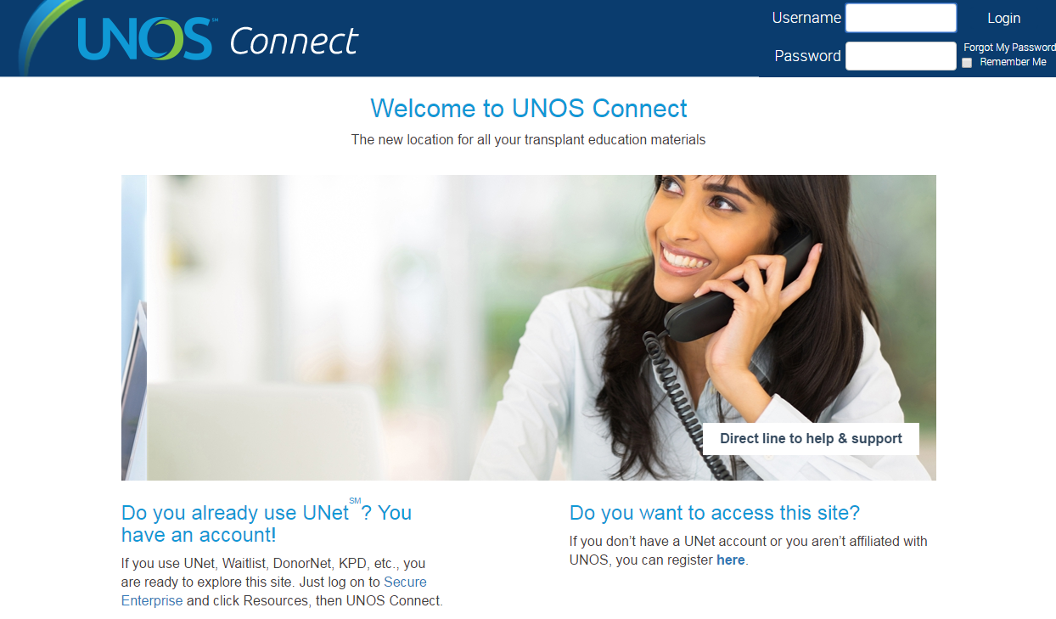
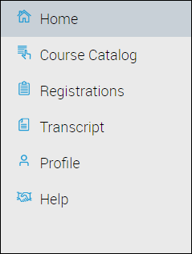
UNOS Connect
For assistance in locating, registering and starting courses, please review help documentation.
Visit UNOS Connect:
https://unosconnect.unos.org
Notes:
All of the TCC Learning Series offerings are available on UNOS Connect, UNOS’ learning management system (LMS). You can access UNOS Connect by going to UNOSConnect.unos.org as shown on this slide.

Slide 5
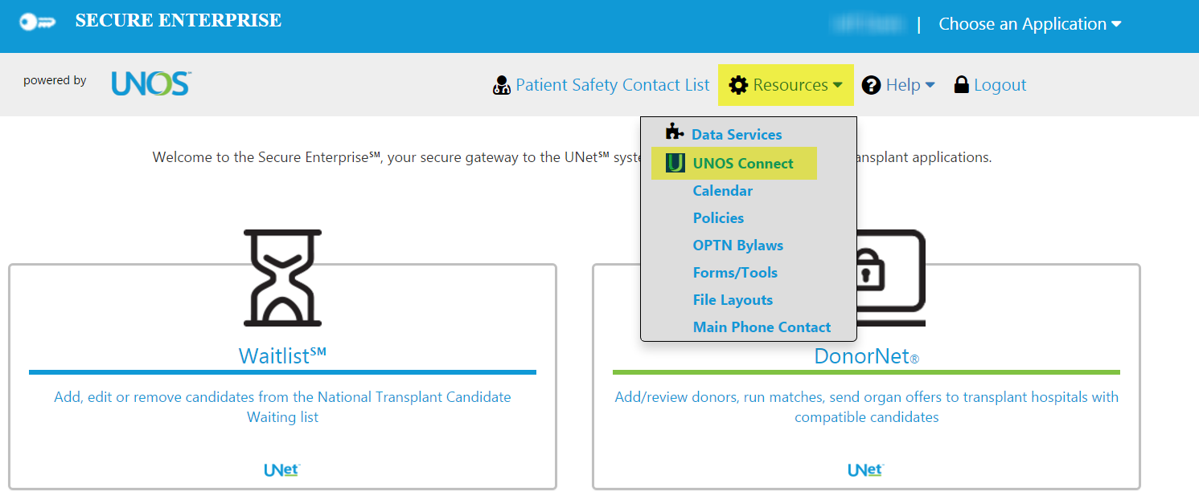
Access offerings through UNetSM
Notes:
Or, if you already have a UNet account, you can log on and find UNOS Connect under the Resources tab.
You can already find the first offering, which is “Role of a Transplant Coordinator” in the UNOS Connect course catalog under the Quality/Effective Practices category. Register for the course and click Entrance Survey to begin.
Due to the waitlist information presented, the second and third offerings: Waitlist Management and Inactive Waitlist Management are only available to those with access to UNet. You can find these in UNOS Connect in the course catalog “Systems” category.
There is also information on how to access these educational offerings on Transplant Pro.
Please contact UNOS Instructional Innovations at education@unos.org, for instructional questions.

Slide 6
Transplant Coordinator Listserv
Join our listserv!
https://groups.yahoo.com/neo/groups/transplant_coordinators/info
Notes:
All transplant coordinators are invited to join the Listserv. It’s an excellent way to receive immediate feedback and advice from your fellow coordinators and learn about educational opportunities. Just use the URL on this slide and follow the instructions.

Slide 7
Questions?
Sarah Nicholas, RN, B.S.N., CCTC
Committee Chair
sarahnicholas@mhd.com
Christopher L. Wholley, M.S.A.
Transplant Community Administrator
christopher.wholley@unos.org

