Slide 1
Eliminate the Use of Regions in VCA Distribution
VCA Transplantation Committee

Slide 2
What problem will the proposal solve?
OPTN Final Rule outlines several requirements for organ allocation policies
“shall not be based on the candidate’s place of residence or place of listing, except to the extent required”
Policy currently uses regions for distribution
Ensure compliance with the Final Rule by removing Region from VCA allocation policy
Notes:
The Final Rule sets requirements for allocation polices developed by the OPTN, including:
Based sound medical judgement,
Find the best use of organs,
Preserve the ability for centers to decide whether to accept an organ offer, and
Promote efficiency and avoid the circumstance of organs recovered and ultimately not transplanted.
The Final Rule also includes a requirement that allocation policies “shall not be based on the candidate’s place of residence or place of listing, except to the extent required” by the other requirements of the Rule.
OPTN Policy currently uses OPTN “regions” for VCA distribution. This is problematic because:
Use of regions are not a good proxy for geographic distance between donors and transplant candidates. Regions have varying size of regions, shapes, and populations. This can result in an inconsistent application for all candidates.
The Goal of this proposal is to ensure compliance with the Final Rule.

Slide 3
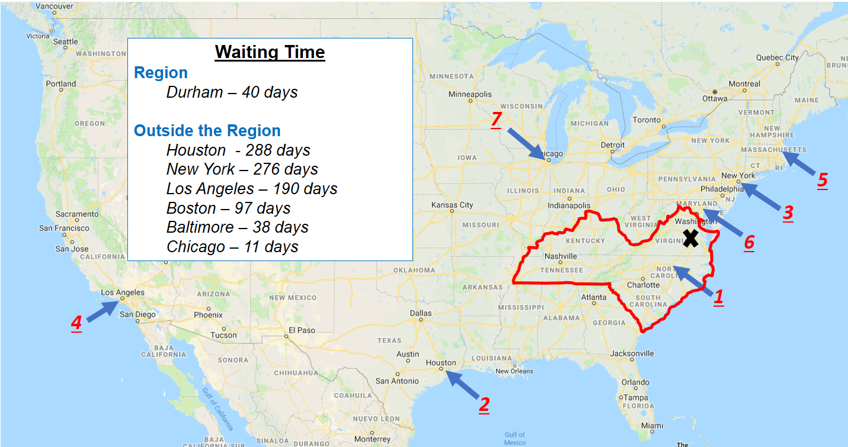
Current VCA Allocation
Notes:
This slide depicts the current VCA allocation policy for a hypothetical deceased donor located in Richmond, Virginia (within Region 11 outlined in red).
The first offer would be to a VCA candidate in Durham, North Carolina, located with the same region as the deceased donor. If the transplant program in Durham refused the offer or the candidate was bypassed, subsequent offers are made outside Region 11 in the following sequence until someone accepts or the waiting list is exhausted:
Houston
New York
Los Angeles
Boston
Baltimore
Chicago
This approach to VCA distribution was based on the precedent set in early organ distribution. The Committee and the transplant community felt this was a prudent manner to initially distribute VCAs within a national system and allow for the collection of data to inform future changes.

Slide 4
What are the proposed solutions?
Replace “region” with a fixed distance
Recommendation: 750 NM
Notes:
This proposal would:
replace use of regions in VCA allocation policies with a fixed distance around a donor hospital.
Recommendation:
a 750 nautical mile fixed distance.
We feel this proposal will address the Secretary’s findings by allowing efficient placement of deceased donor VCAs, help achieve optimal recipient and graft outcomes, and to reduce the risk of organs being recovered but not transplanted.
We are also seeking feedback if another distance should be considered. This will be explained shortly.

Slide 5
Supporting Evidence per the Final Rule
Based in sound medical judgement
Literature and expert input
Seeks to achieve the best use of donated organs
CIT and outcomes
Promote the efficient management of organ placement
Focusing initial VCA allocation efforts
Notes:
The evidence for this proposal not only informed our discussions, but also provides connection to the Final Rule:
Based in sound medical judgement by being data driven, through available literature and expert input
Seeks to achieve the best use of donated organs by considering available OPTN data on cold ischemic time and outcomes
Promote the efficient management of organ placement by focusing initial VCA allocation efforts to those transplant programs likely to accept a VCA offer within a geographic distance

Slide 6
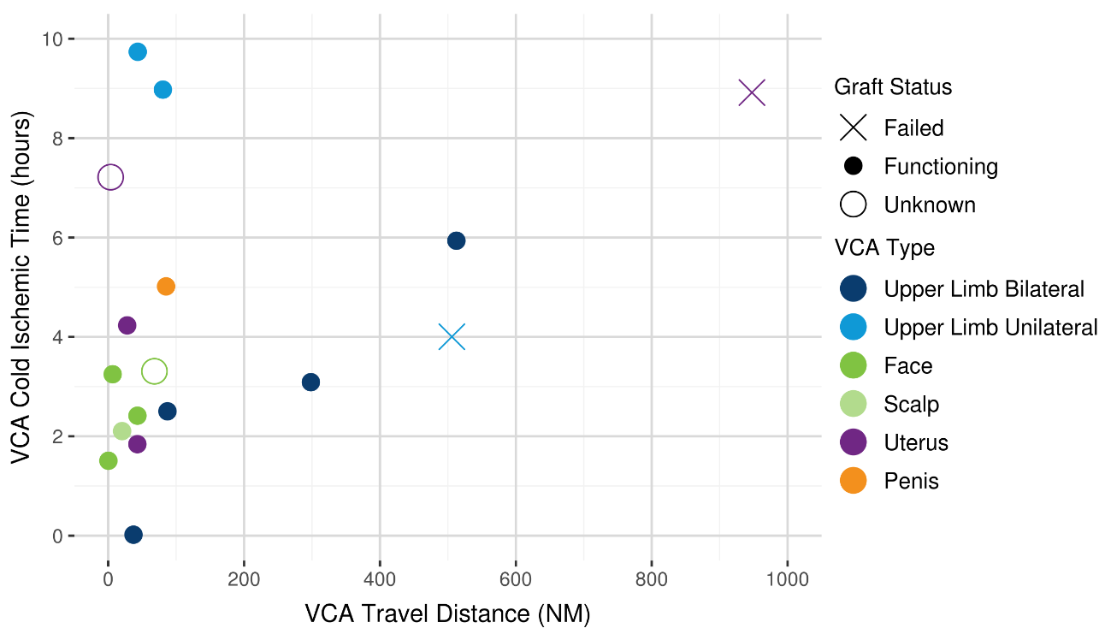
Supporting Evidence
Notes:
We recognized that some VCA programs appeared to be traveling farther distances since the first VCA transplant in 1998. This slide illustrates that:
18 of 24 VCAs transplanted (75%) since July 2014 were recovered within 200 NM of the VCA transplant program.
21 of 24 VCAs transplanted (87.5%) were recovered within 500 NM of the VCA transplant program.
This is:
informative and useful data
shows whether the VCA is functioning, has failed, or the status is unknown
Likely reflective the preferences of individual teams and the unique needs of the respective transplant candidates
This is not:
Data that correlates specific VCA transplant outcomes with cold ischemic time
We reviewed available literature reports of ischemic times in VCA transplantation, but these papers also did not report finding correlations between VCA transplant outcomes and CIT.
We discussed four intervals for a fixed distance, 250, 500, 750 nautical miles, and more than 750 NM. 250 NM was felt to too short, and distances over 750 NM were felt to be excessive. We were split over 500 NM or 750 NM. The following slides show what each option may look like.

Slide 7
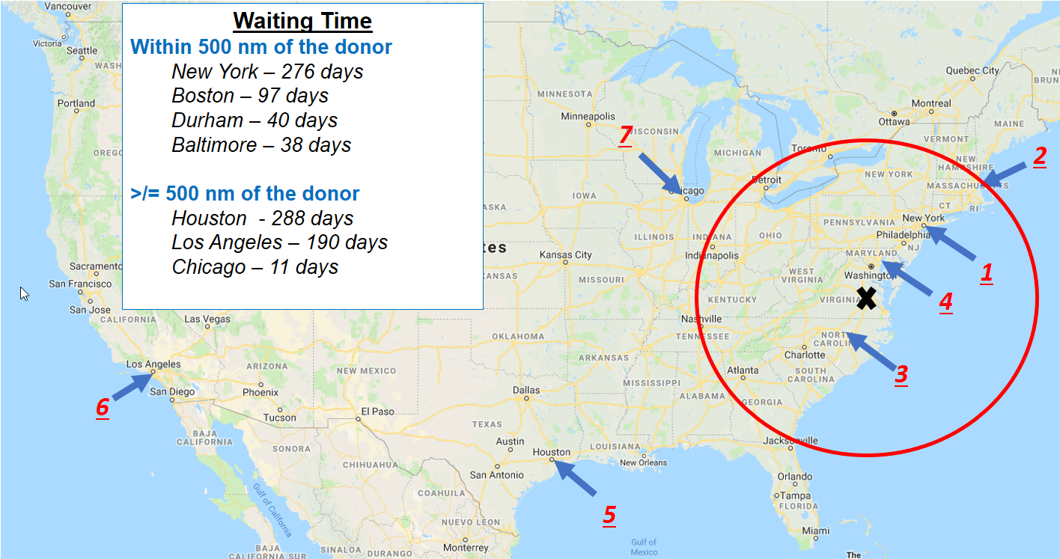
500 NM distribution
Notes:
Using the same scenario as the early slide under the 500 NM concept, the first offer would be made to a VCA candidate in New York, as this candidate has the highest amount of waiting time within the 500 NM distance from the donor hospital. If the offer to the candidate in New York was refused or the candidate was bypassed, subsequent offers would be made in the following sequence within the 500 NM distance:
Boston
Durham
Baltimore
If offers to the candidates in Boston, Durham, and Baltimore were refused or the candidates were bypassed, subsequent offers would be made until acceptance or the waiting list was exhausted:
Houston
Los Angeles
Chicago

Slide 8
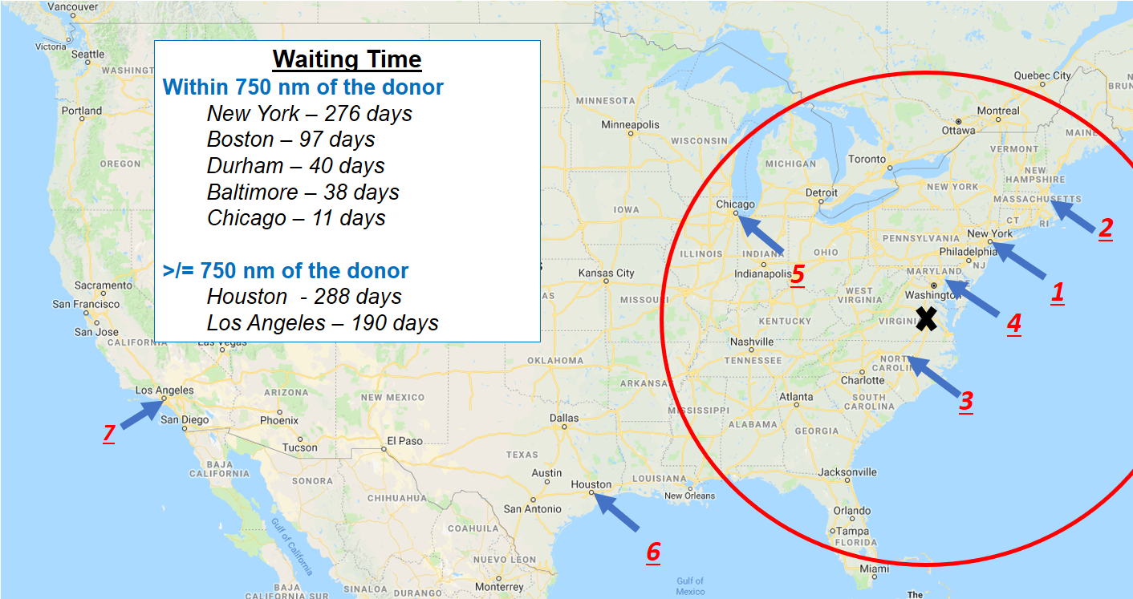
750 NM distribution
Notes:
Considering the 750 NM concept, the first offer would be made to a VCA candidate in New York City, as this candidate has the highest amount of waiting time within the 750 NM distance from the donor hospital. If the offer to the candidate in New York City was refused or the candidate was bypassed, subsequent offers would be made in the following sequence within the 750 NM distance:
Boston
Durham
Baltimore
Chicago
If offers to the candidates in Boston, Durham, Baltimore, and Chicago were refused or the candidates we bypassed, subsequent offers would be made until acceptance or the waiting list was exhausted:
Houston
Los Angeles

Slide 9
Feedback requested
Recommend an alternative distance for VCA distribution?
What evidence supports your rationale?
Notes:
The Committee encourages all interested individuals to comment on the proposal in its entirety. The Committee requests feedback on the following items:
1. Do you recommend an alternative distance for VCA distribution, versus the proposed distance of 750 NM?
2. What evidence supports your rationale?

Slide 10
How will members implement this proposal?
VCA Transplant Programs
Small # of additional data with candidate registrations
VCA transplant programs may need to develop working relationships with OPOs within an acceptable travel distance
Notes:
Let’s look at what this would mean for VCA transplant programs and OPOs:
VCA Transplant Programs:
This proposal will require VCA transplant programs to submit a small amount of additional data to the OPTN when registering a VCA candidate.
VCA transplant programs will continue to receive offers from OPOs, however these offers may come from OPOs they have not worked with before.
VCA transplant programs may need to develop working relationships with any OPO within what the VCA program believes is an acceptable travel distance in order to obtain needed donor information and coordinate VCA recovery.

Slide 11
How will members implement this proposal?
OPOs
Collaborate with VCA program within 750 NM
Encourage transparency of recovery costs
Notes:
Whether you have recovered VCAs before or are considering this for the first time:
OPOs are strongly encouraged to assess what VCA programs are within 750 miles of their DSA. You may need to develop working relationships with VCA programs you’ve not worked with before in order to share needed donor information and coordinate VCA recovery.
We encourage OPOs and VCA programs to discuss any potential VCA acquisition costs before any VCA recoveries occur.

Slide 12
How will the OPTN implement this proposal?
No programming changes in UNet
Notes:
This proposal will not require programming in UNet since the VCA candidate registration/removal and VCA allocation system exists outside of UNet.
Enhancements to the VCA candidate registration/removal and VCA allocation system will be needed to:
sort potential recipients based on distance from a donor hospital.
reduce administrative burden to OPOs and the OPTN.

Slide 13
Questions

Slide 14
Reserve Slides

Slide 15
Distribution Type for Deceased Donor VCA Transplants in the US after July 3, 2014

Slide 16
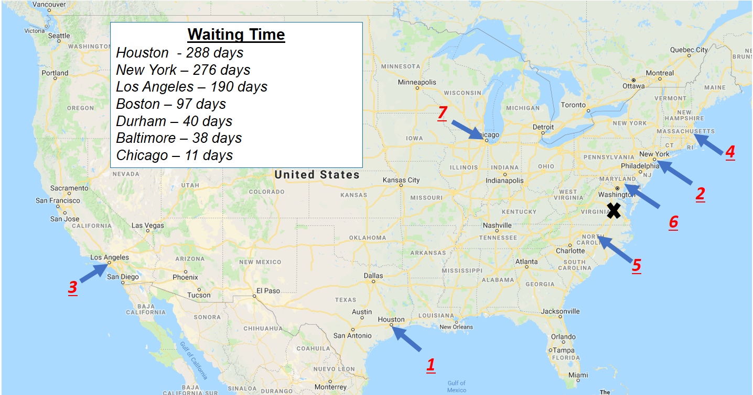
National Distribution
Notes:
Using a model of national distribution based on a VCA candidates waiting time, the first offer would be to a VCA candidate in Houston, Texas. If the transplant program in Houston refuses the offer or bypasses the candidate, subsequent offers are made in the following sequence until someone accepts or the waiting list is exhausted:
New York
Los Angeles
Boston
Durham
Baltimore
Chicago
While this model would promote the widest sharing possible, the we felt such an allocation policy would lead to inefficiencies and risk dis-incentivizing OPOs to screen deceased donors for VCA donation.

